Slide 1
Collection of task examples

Slide 2
Part I: Top-rated user questions
String concatenation
Order (limit)
Finding duplicates
Case analysis / if then else
Random row
Argmax
Sub-query
Count
Date manipulation

Slide 3
Other less frequent questions
Moving average
Exists other column with condition
Join tables avoiding some rows
Pivot table (actually included in concatenation)

Slide 4
String concatenation

Slide 5
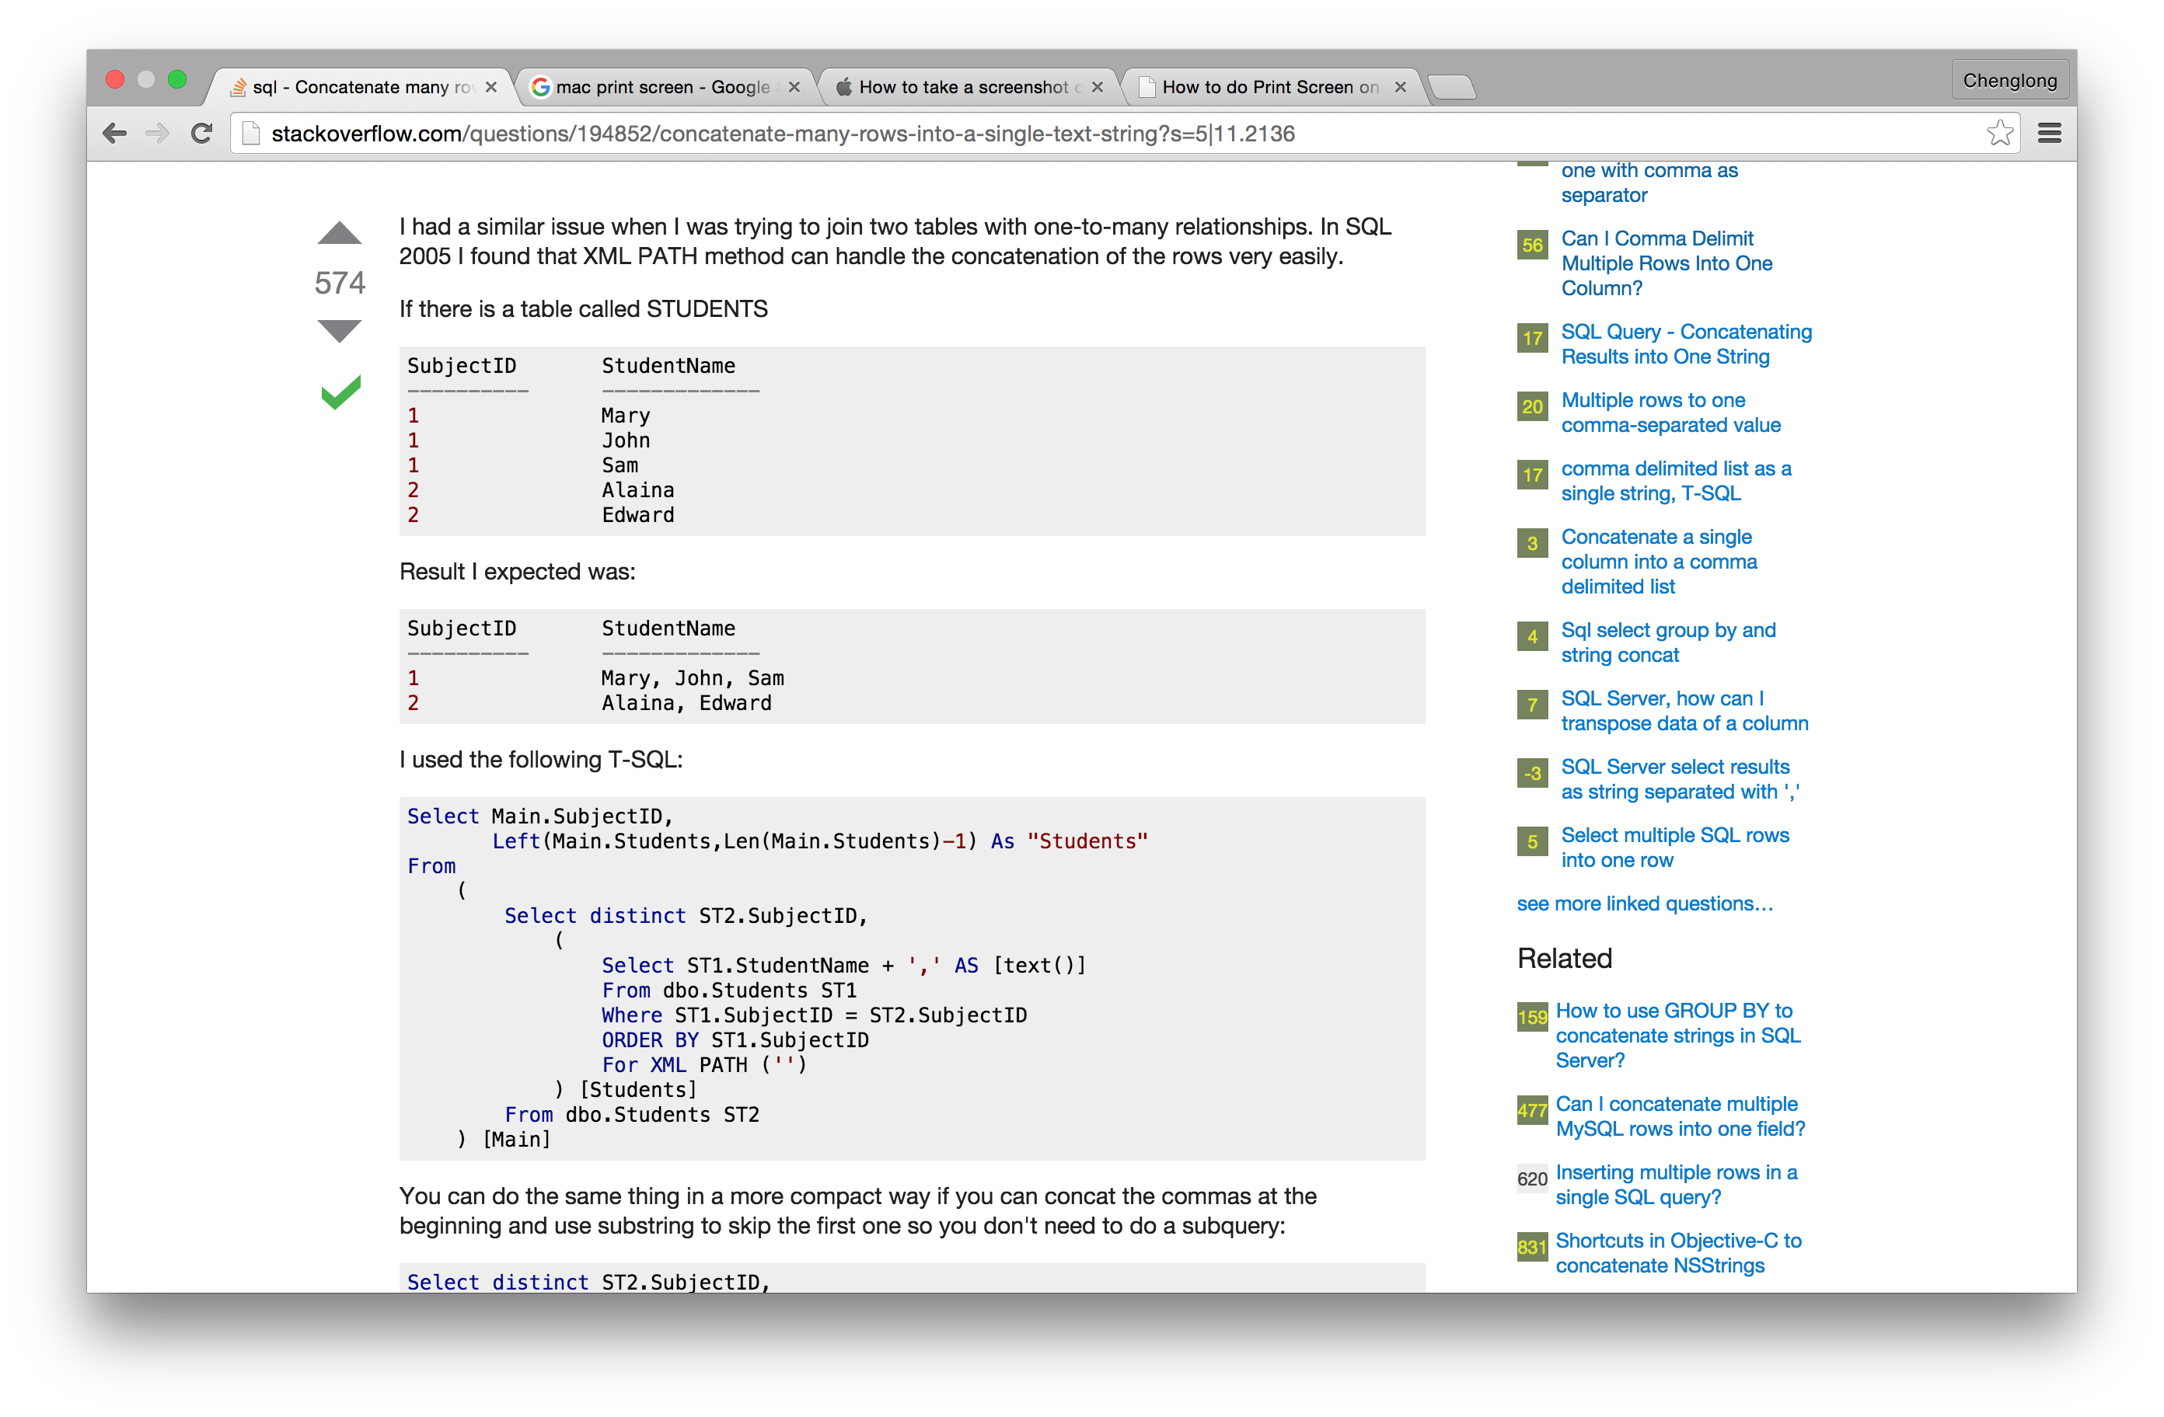
http://stackoverflow.com/questions/194852/concatenate-many-rows-into-a-single-text-string?s=5|11.2136

Slide 6
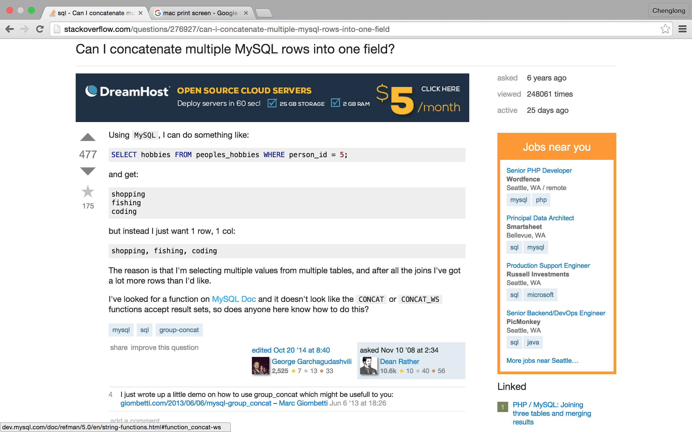
http://stackoverflow.com/questions/276927/can-i-concatenate-multiple-mysql-rows-into-one-field

Slide 7
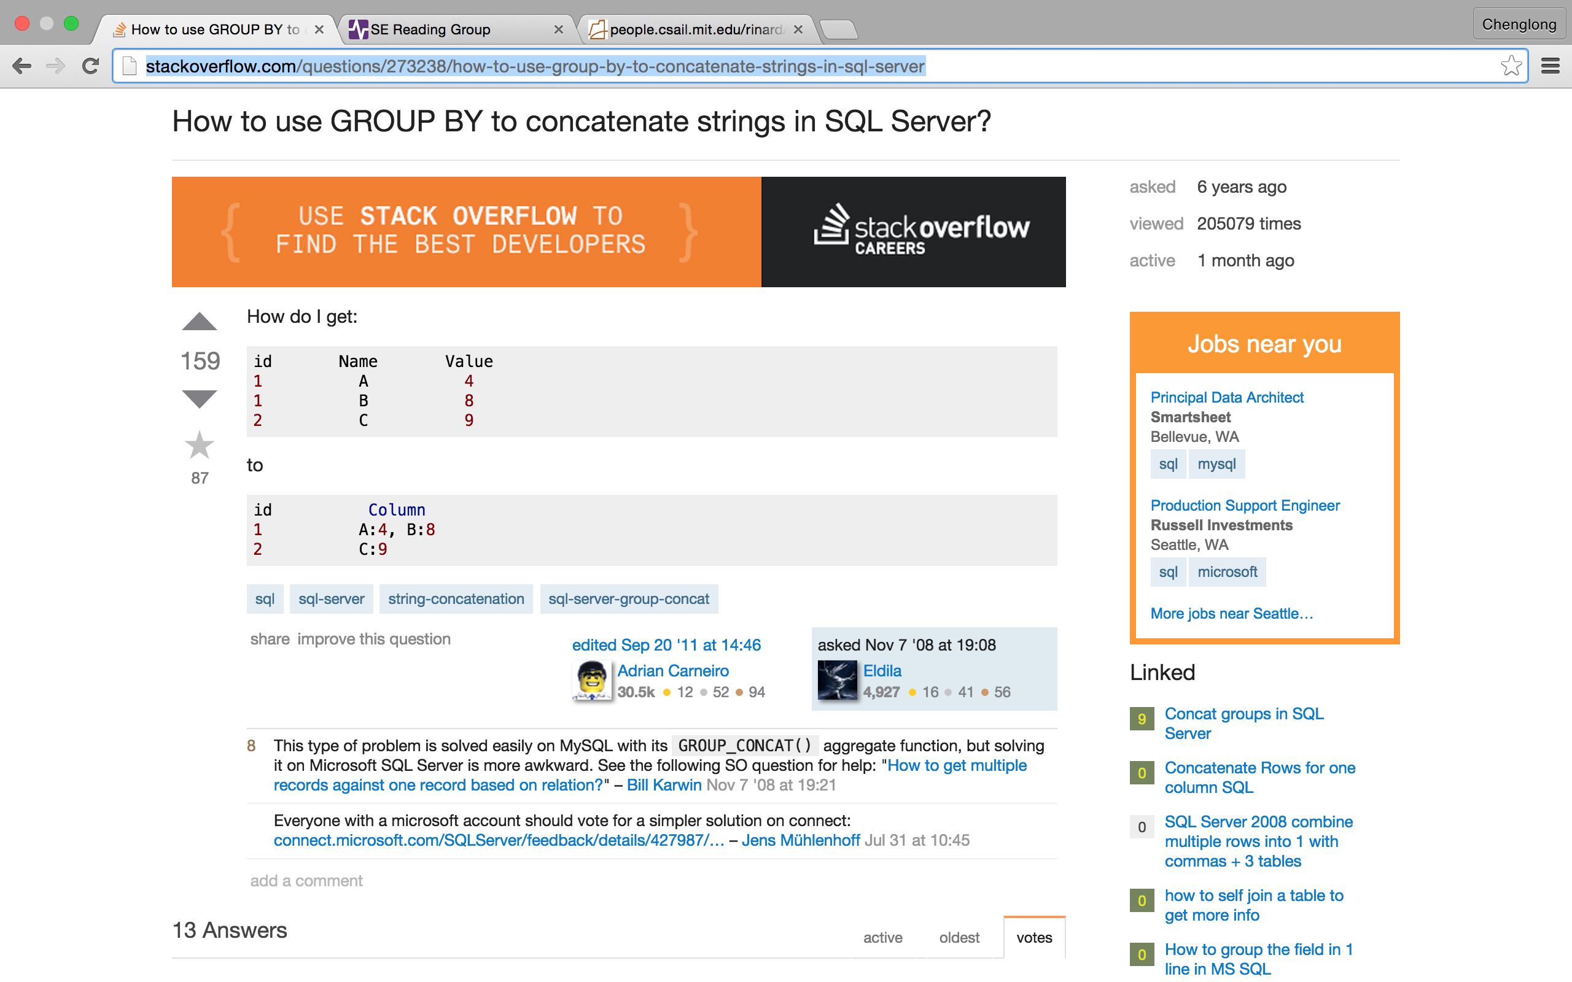
http://stackoverflow.com/questions/273238/how-to-use-group-by-to-concatenate-strings-in-sql-server

Slide 8
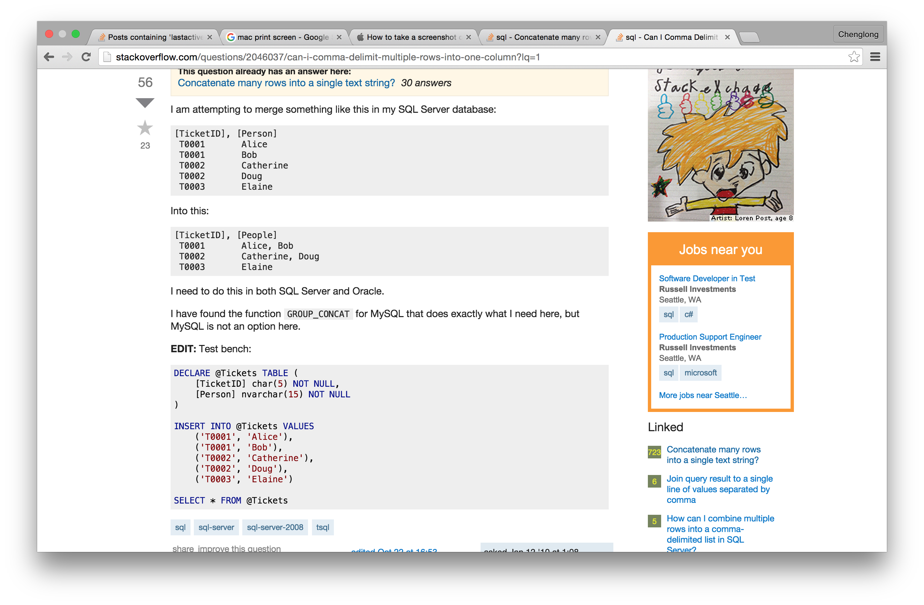
http://stackoverflow.com/questions/2046037/can-i-comma-delimit-multiple-rows-into-one-column?lq=1

Slide 9
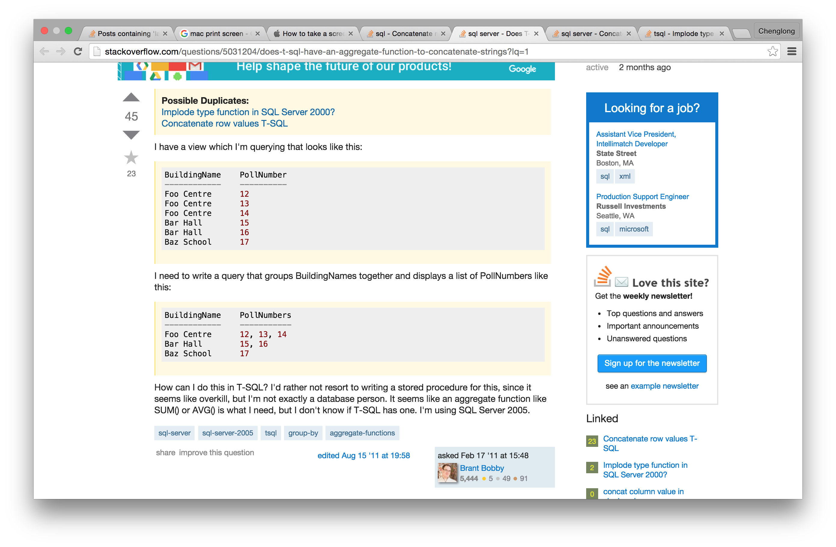
http://stackoverflow.com/questions/5031204/does-t-sql-have-an-aggregate-function-to-concatenate-strings?lq=1

Slide 10
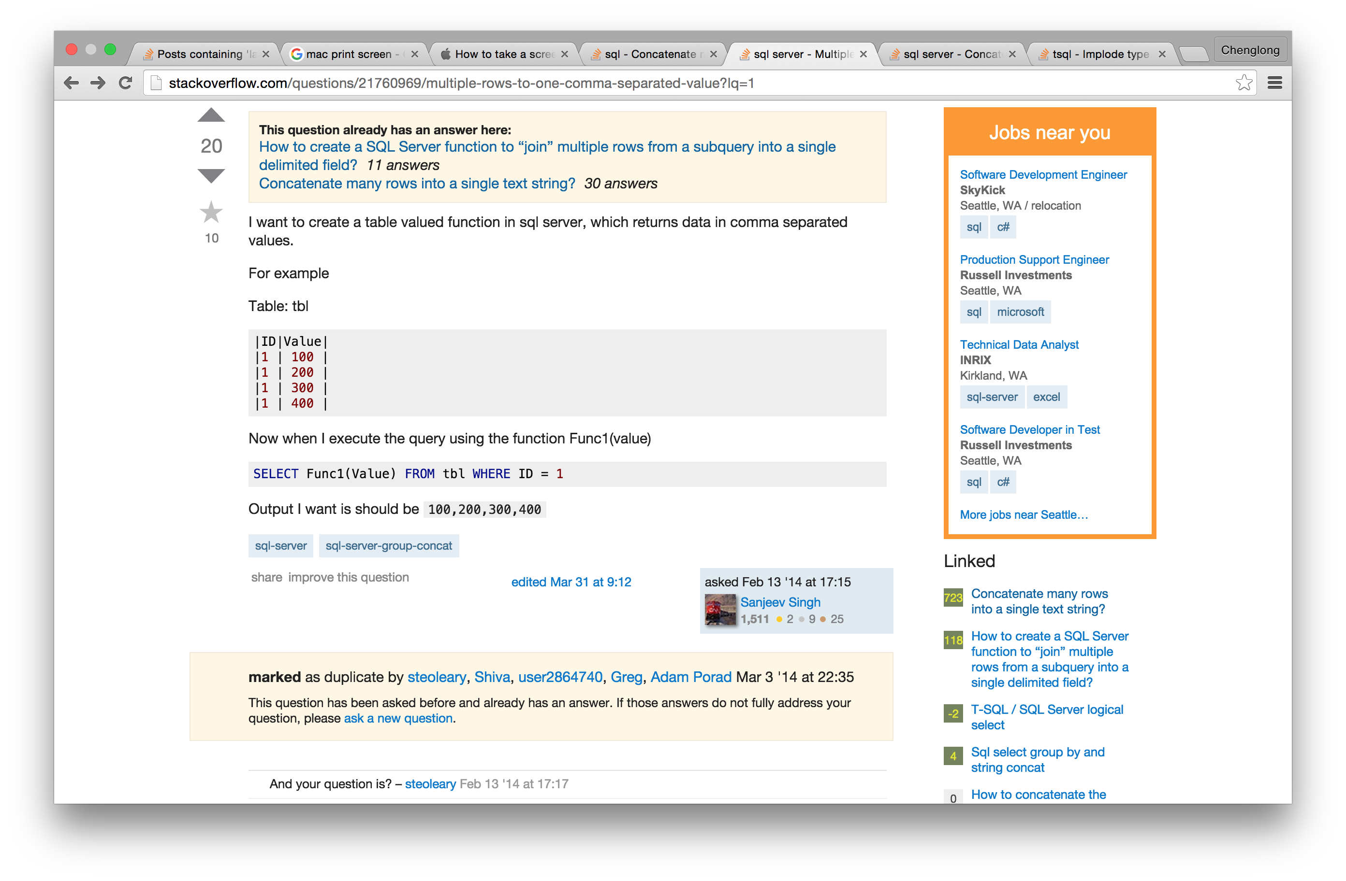
http://stackoverflow.com/questions/21760969/multiple-rows-to-one-comma-separated-value?lq=1

Slide 11
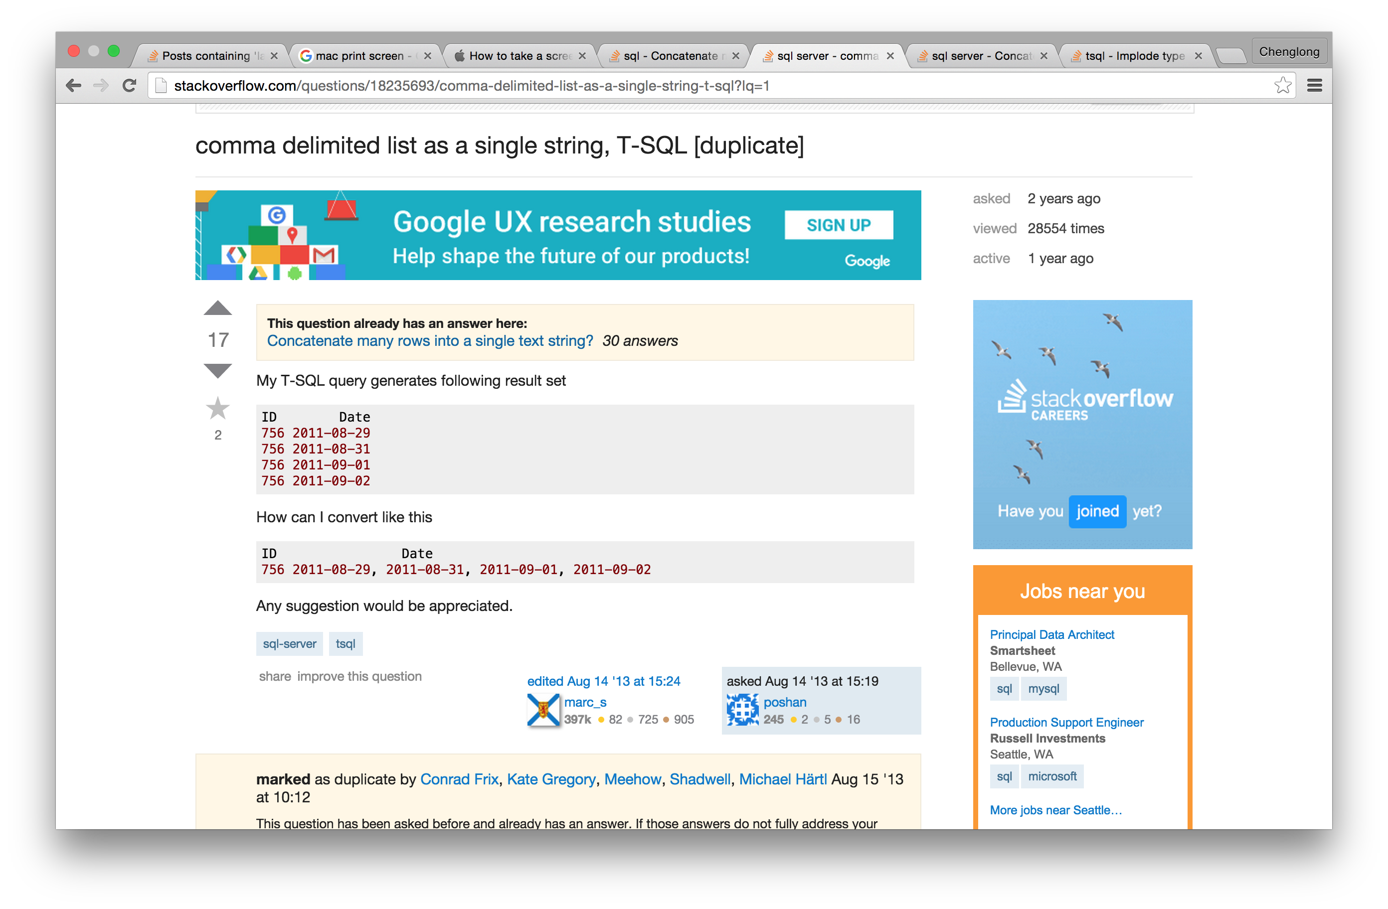
http://stackoverflow.com/questions/18235693/comma-delimited-list-as-a-single-string-t-sql?lq=1

Slide 12
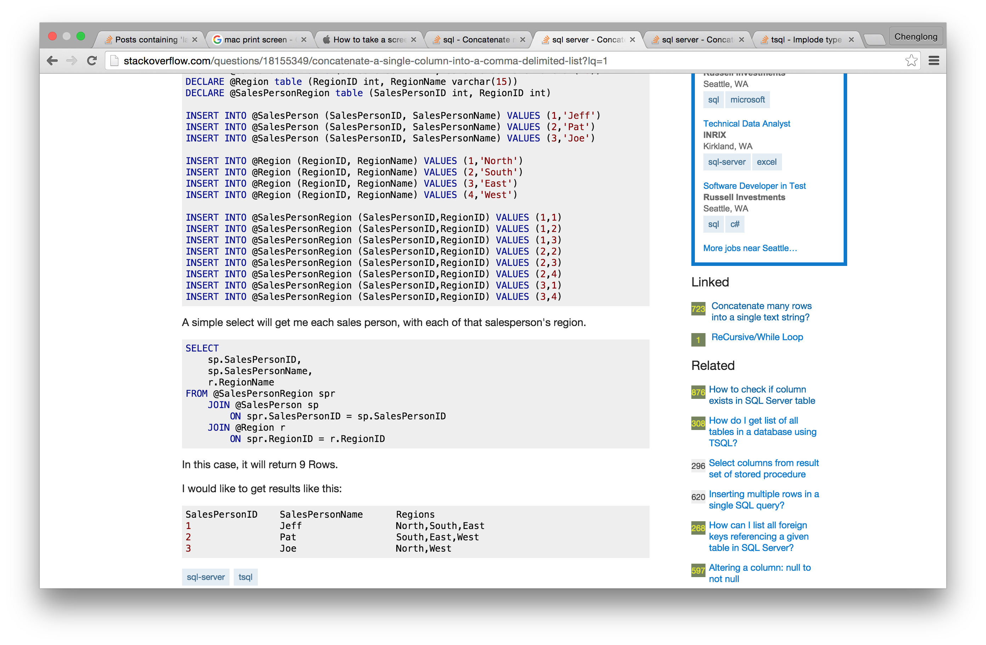
http://stackoverflow.com/questions/18155349/concatenate-a-single-column-into-a-comma-delimited-list?lq=1

Slide 13
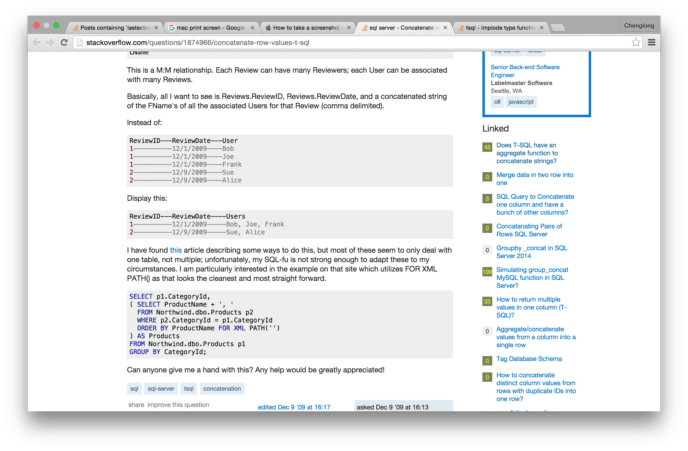
http://stackoverflow.com/questions/1874966/concatenate-row-values-t-sql

Slide 14
Order
(Order and limit)
(Order after union)
(Order by multiple column)

Slide 15
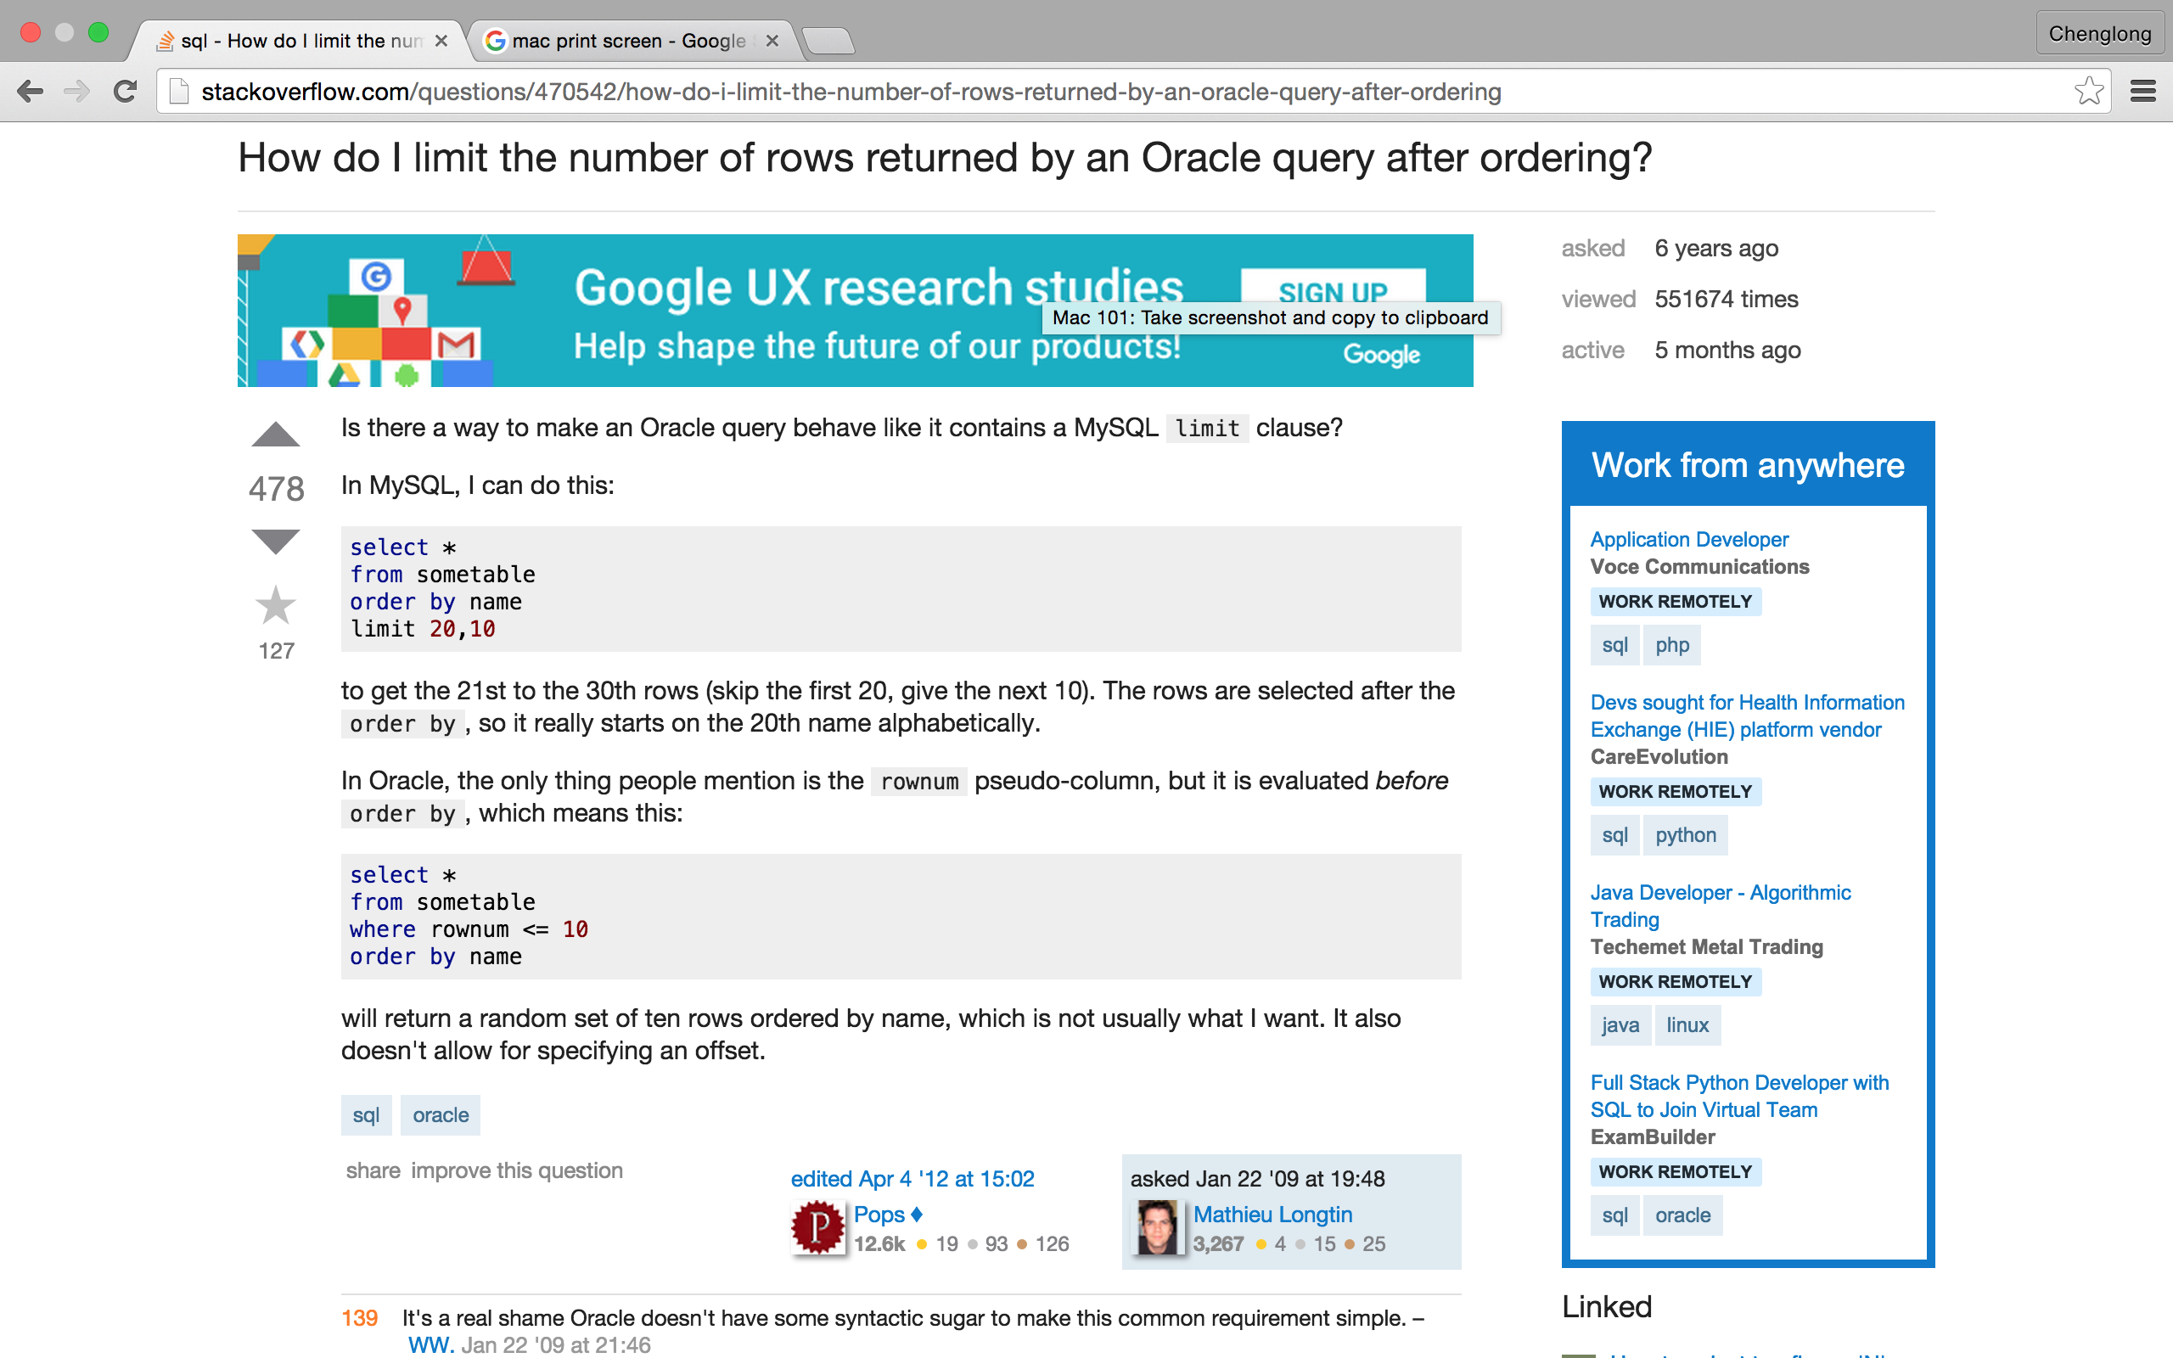
http://stackoverflow.com/questions/470542/how-do-i-limit-the-number-of-rows-returned-by-an-oracle-query-after-ordering

Slide 16
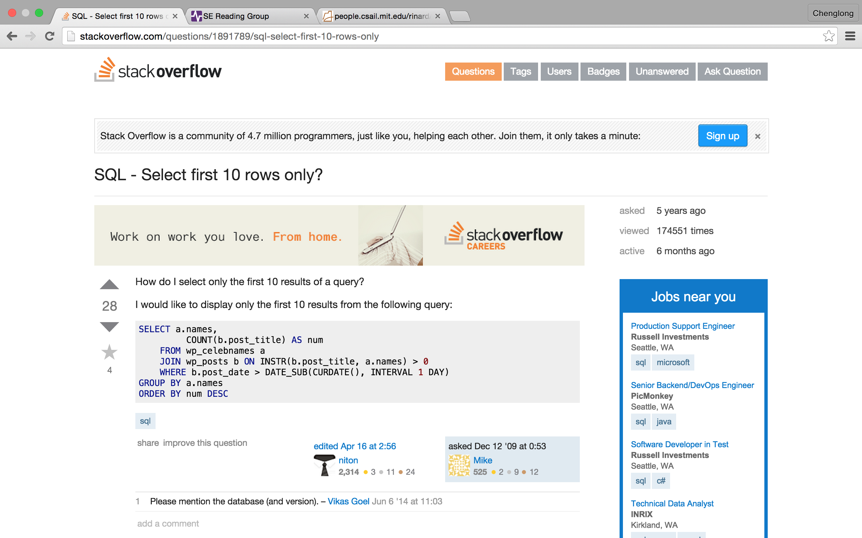
http://stackoverflow.com/questions/1891789/sql-select-first-10-rows-only

Slide 17
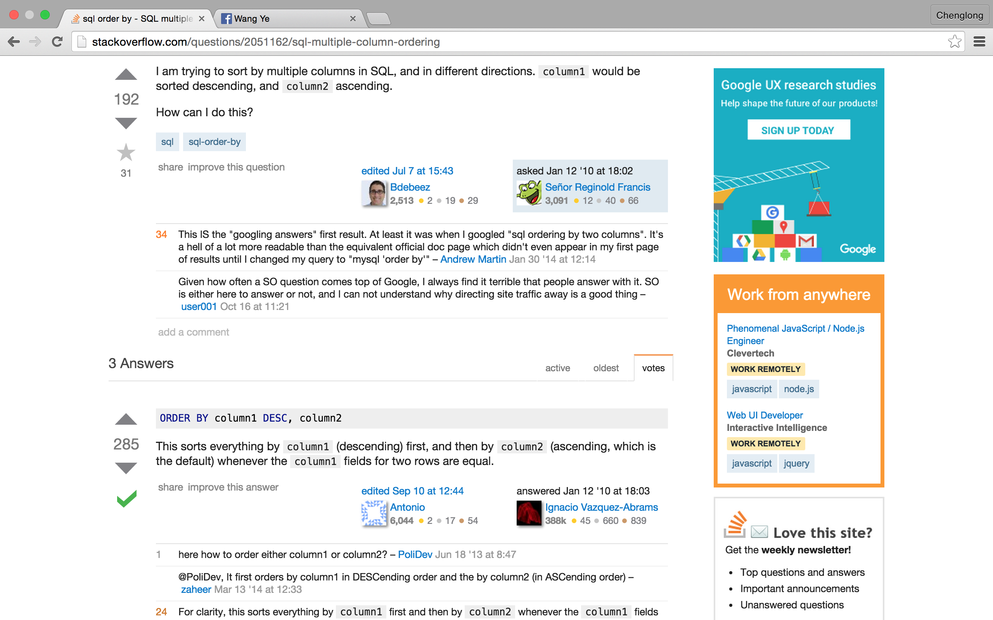
http://stackoverflow.com/questions/2051162/sql-multiple-column-ordering

Slide 18
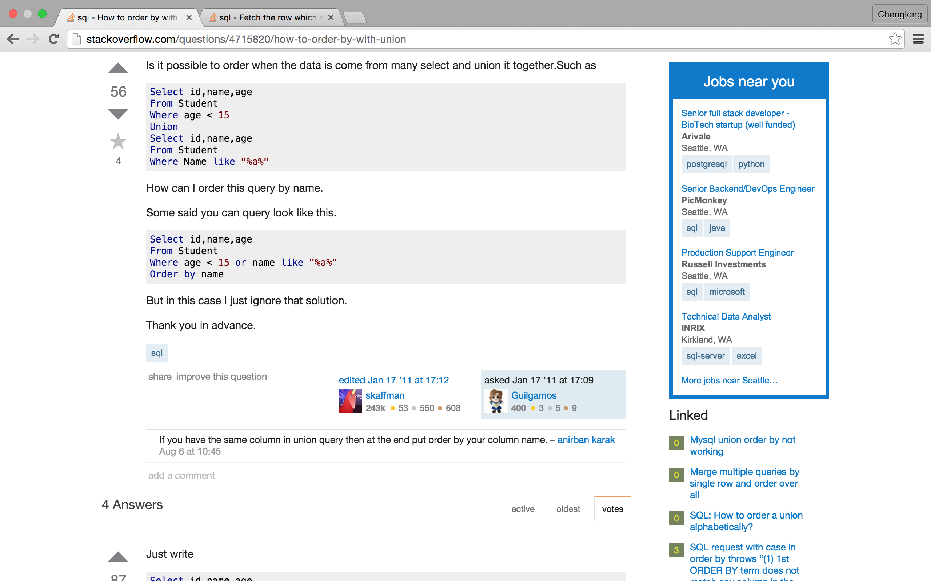
http://stackoverflow.com/questions/4715820/how-to-order-by-with-union

Slide 19
Finding/removing duplicates

Slide 20
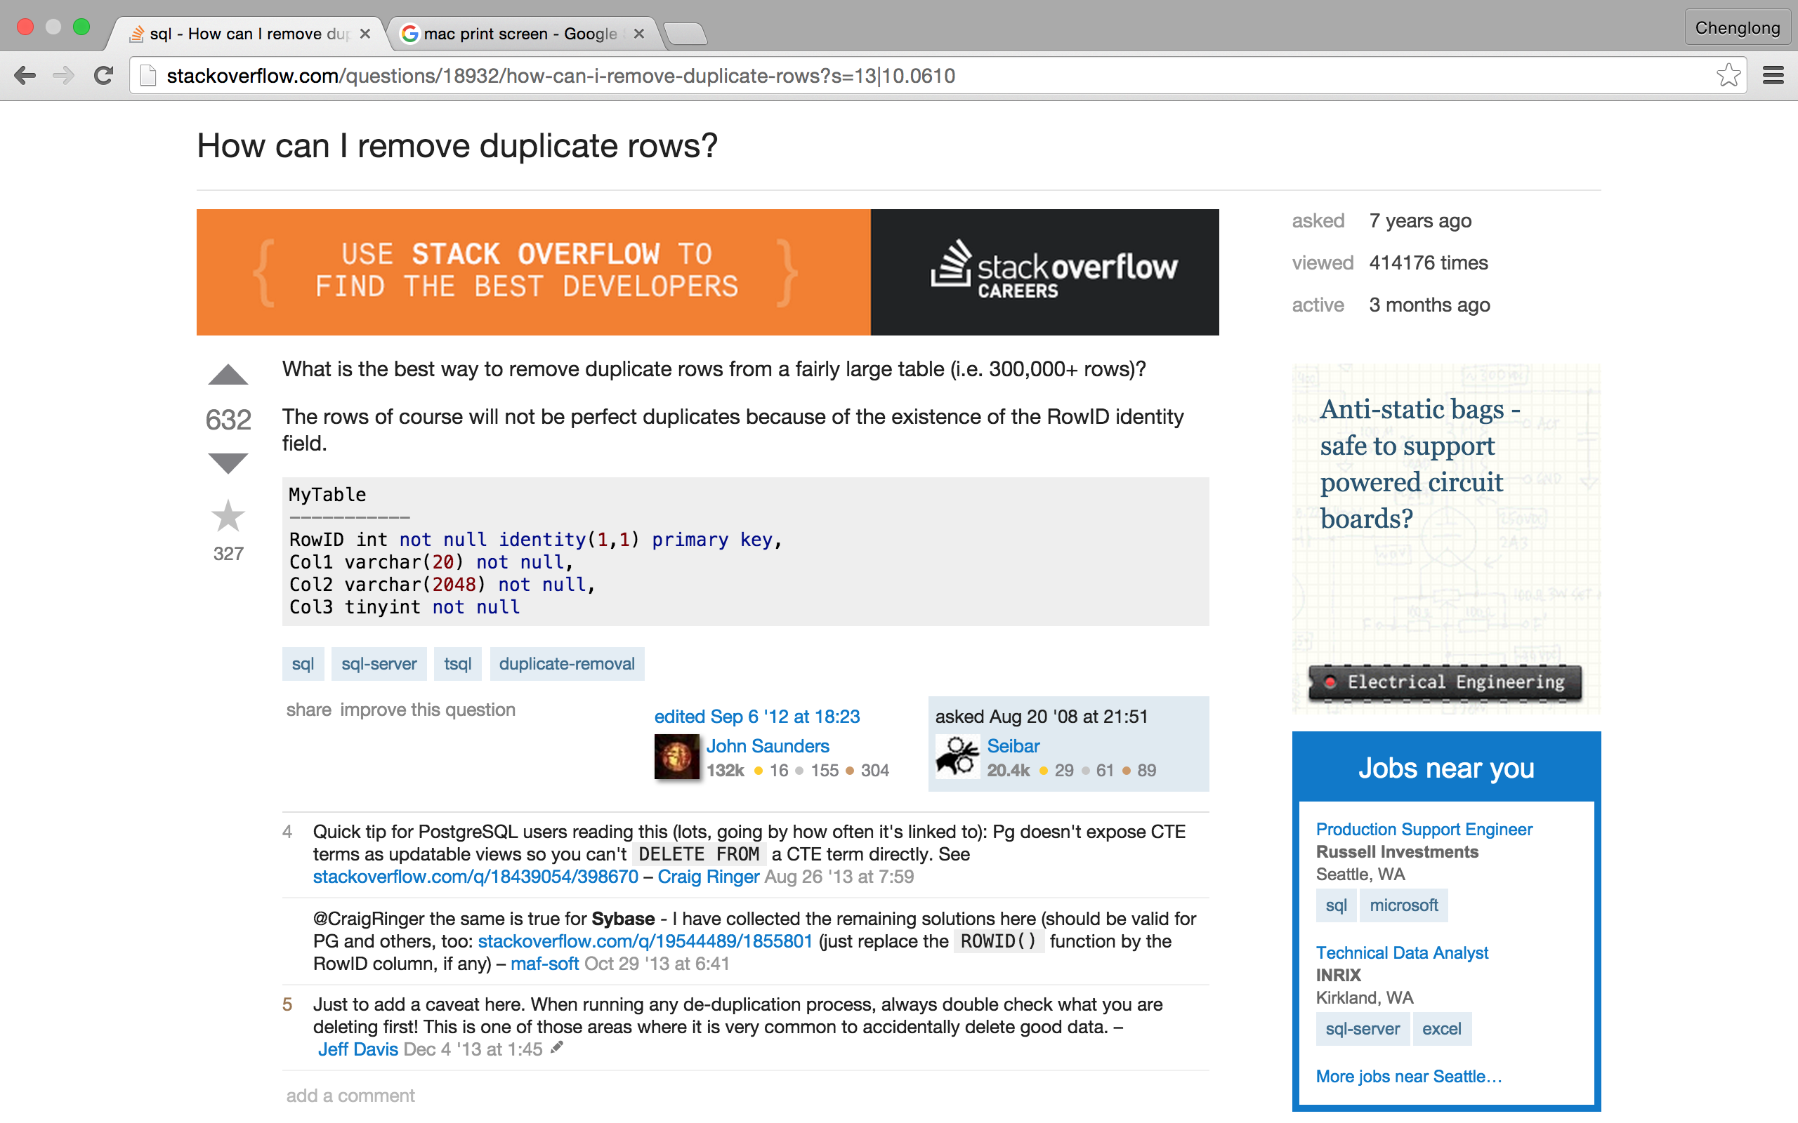
http://stackoverflow.com/questions/18932/how-can-i-remove-duplicate-rows?s=13|10.0610

Slide 21
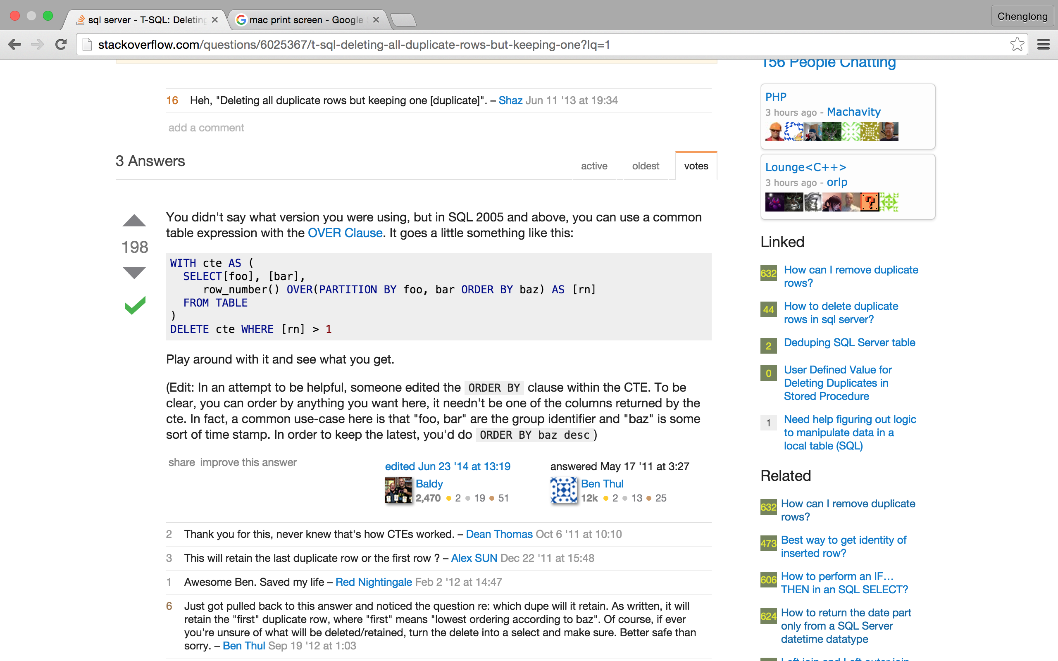
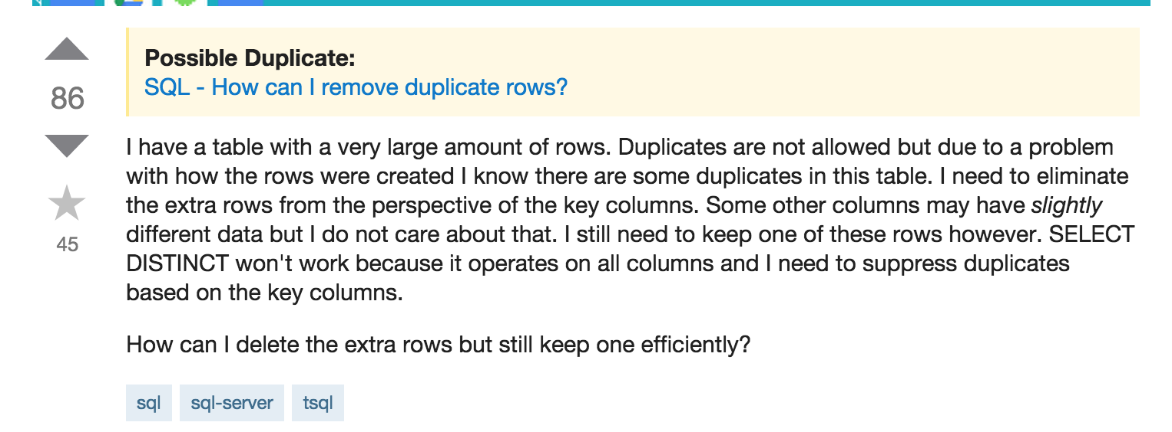
http://stackoverflow.com/questions/6025367/t-sql-deleting-all-duplicate-rows-but-keeping-one?lq=1

Slide 22
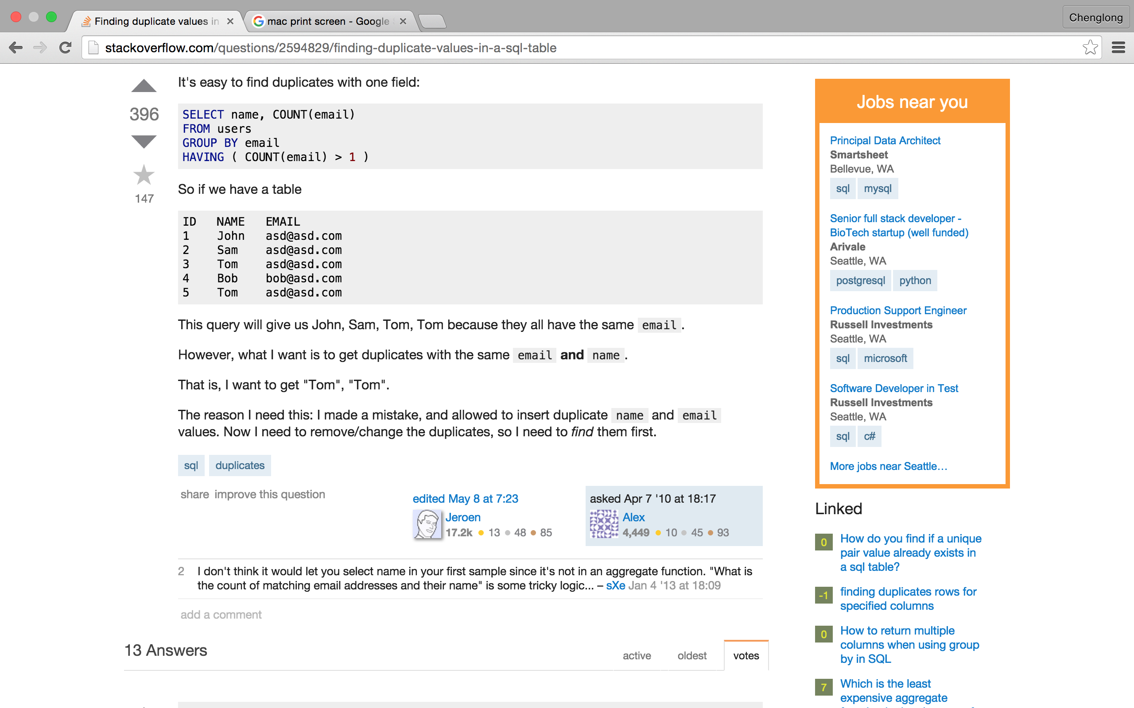
http://stackoverflow.com/questions/2594829/finding-duplicate-values-in-a-sql-table

Slide 23
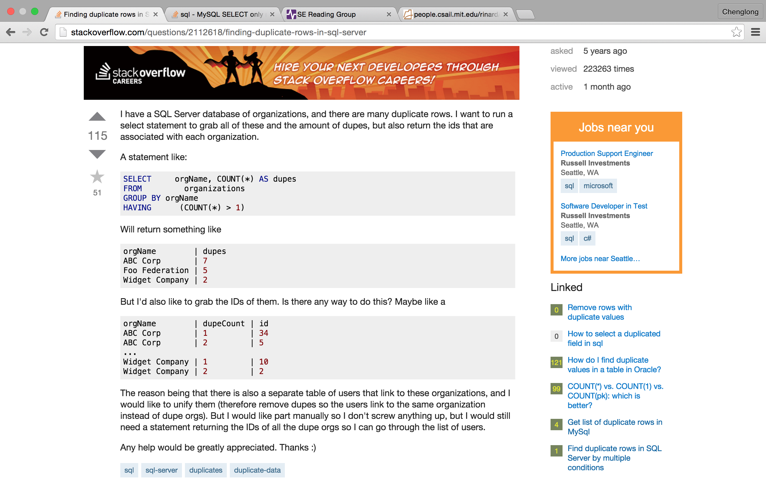
http://stackoverflow.com/questions/2112618/finding-duplicate-rows-in-sql-server

Slide 24
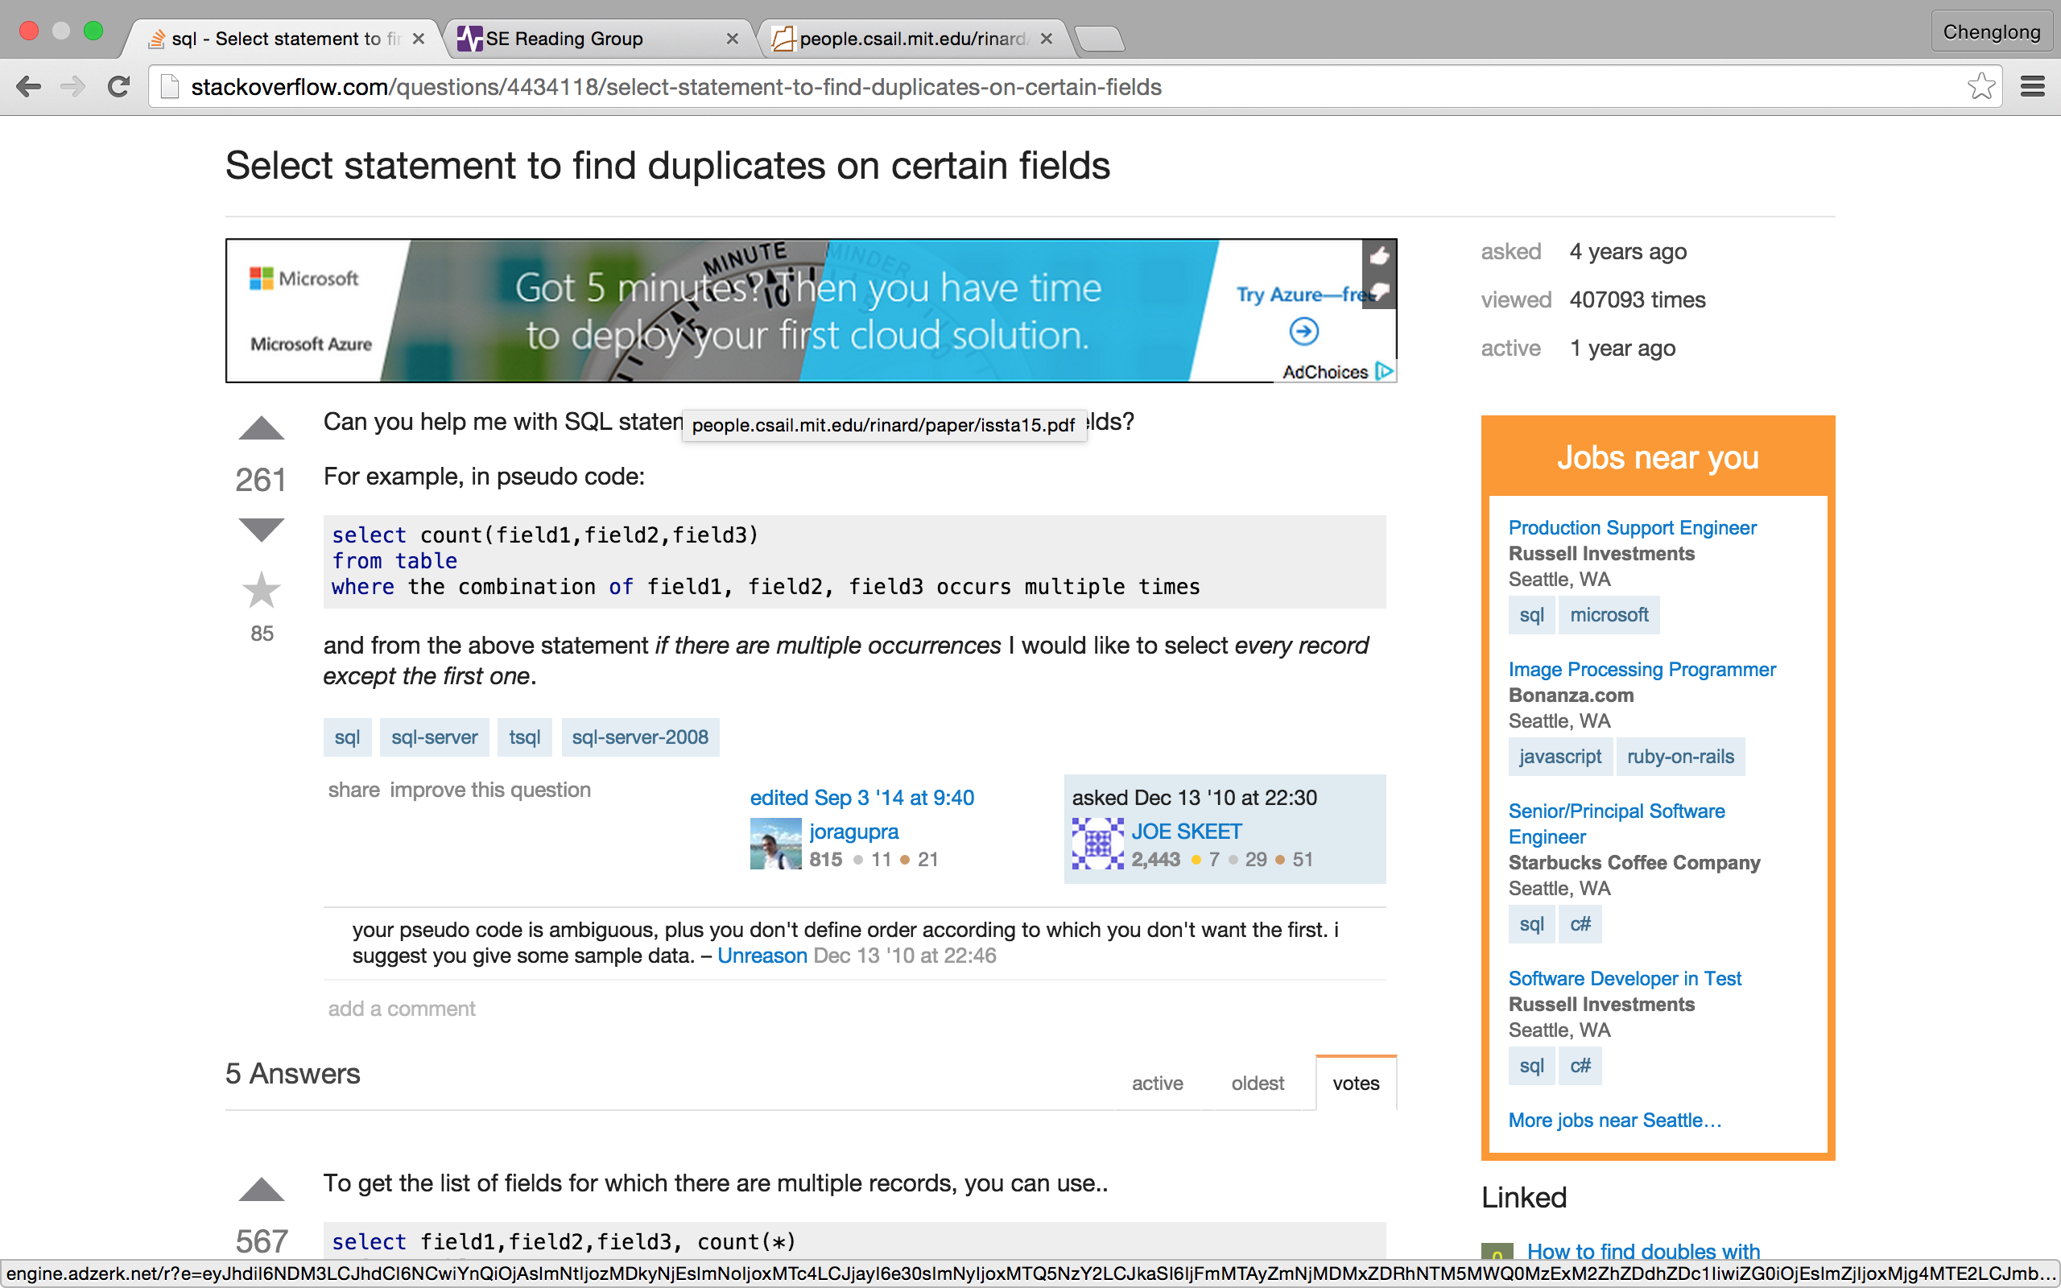
http://stackoverflow.com/questions/4434118/select-statement-to-find-duplicates-on-certain-fields

Slide 25
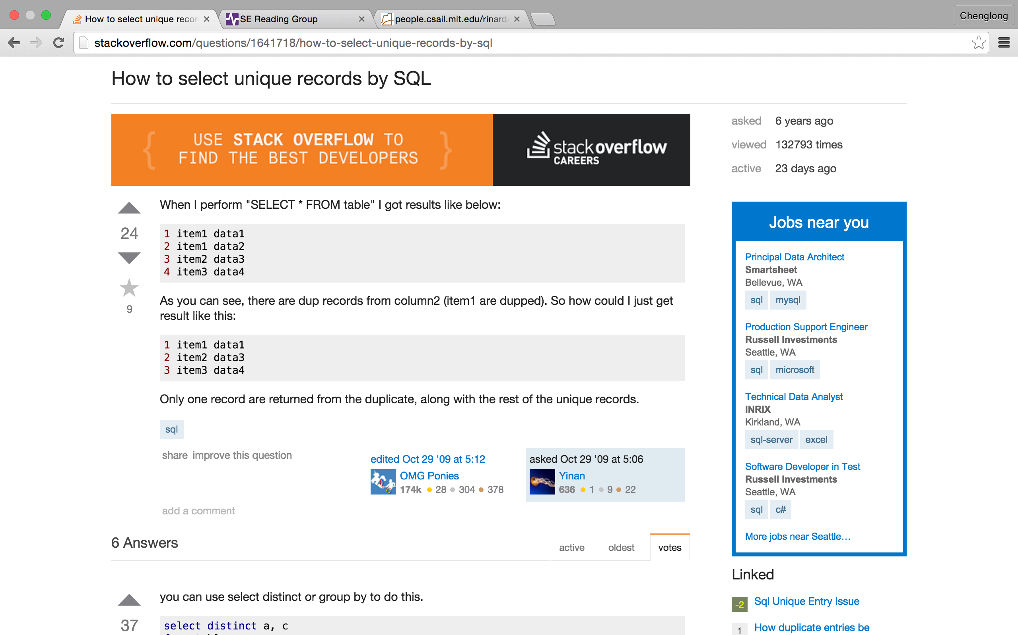
http://stackoverflow.com/questions/1641718/how-to-select-unique-records-by-sql

Slide 26
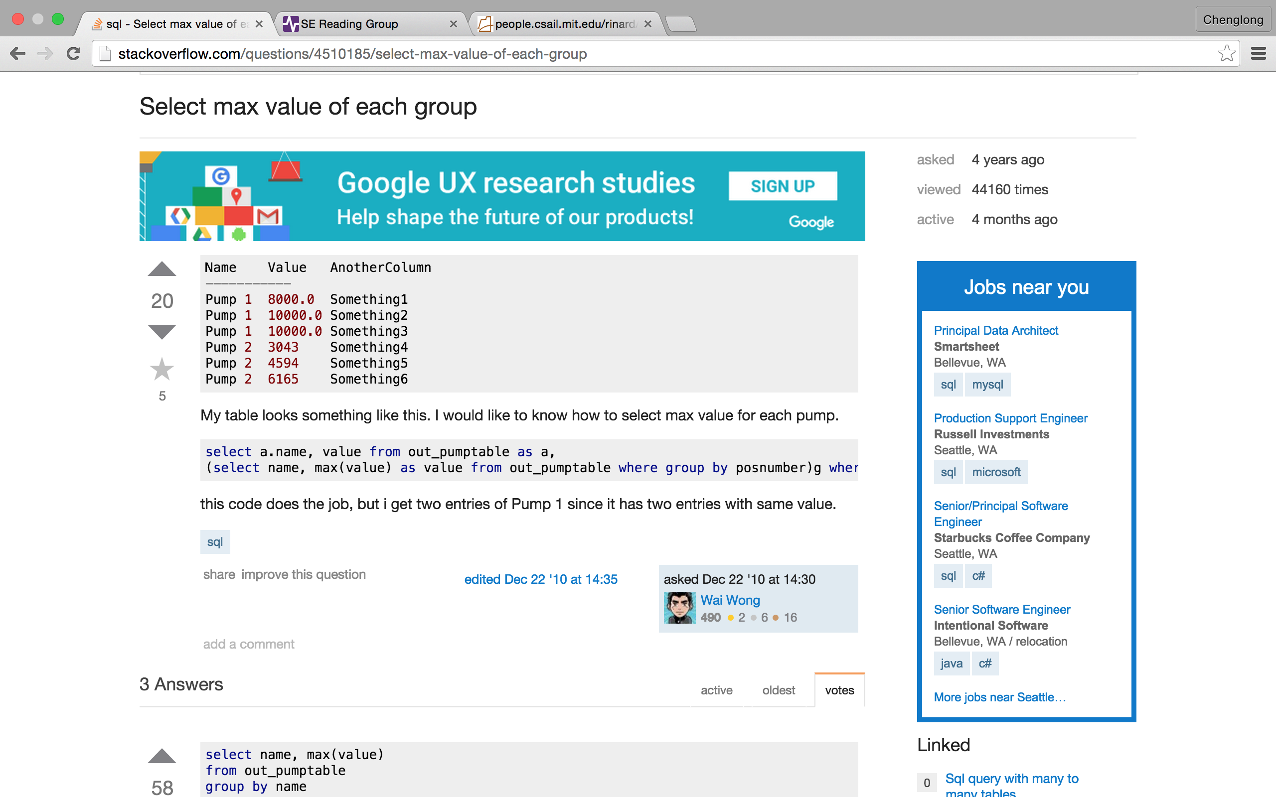
http://stackoverflow.com/questions/4510185/select-max-value-of-each-group

Slide 27
Case analysis in SQL

Slide 28
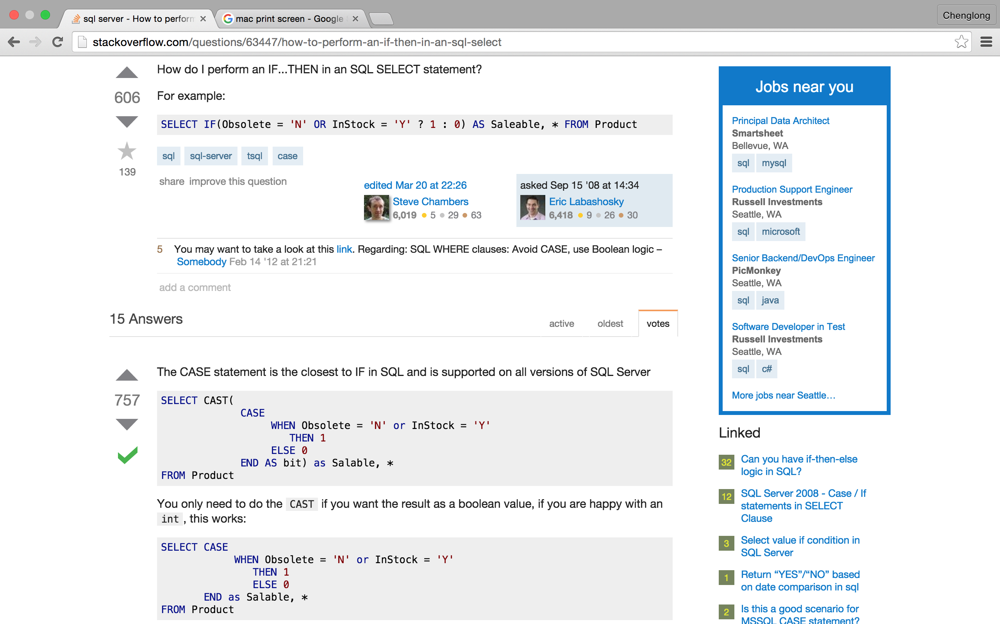
http://stackoverflow.com/questions/63447/how-to-perform-an-if-then-in-an-sql-select

Slide 29
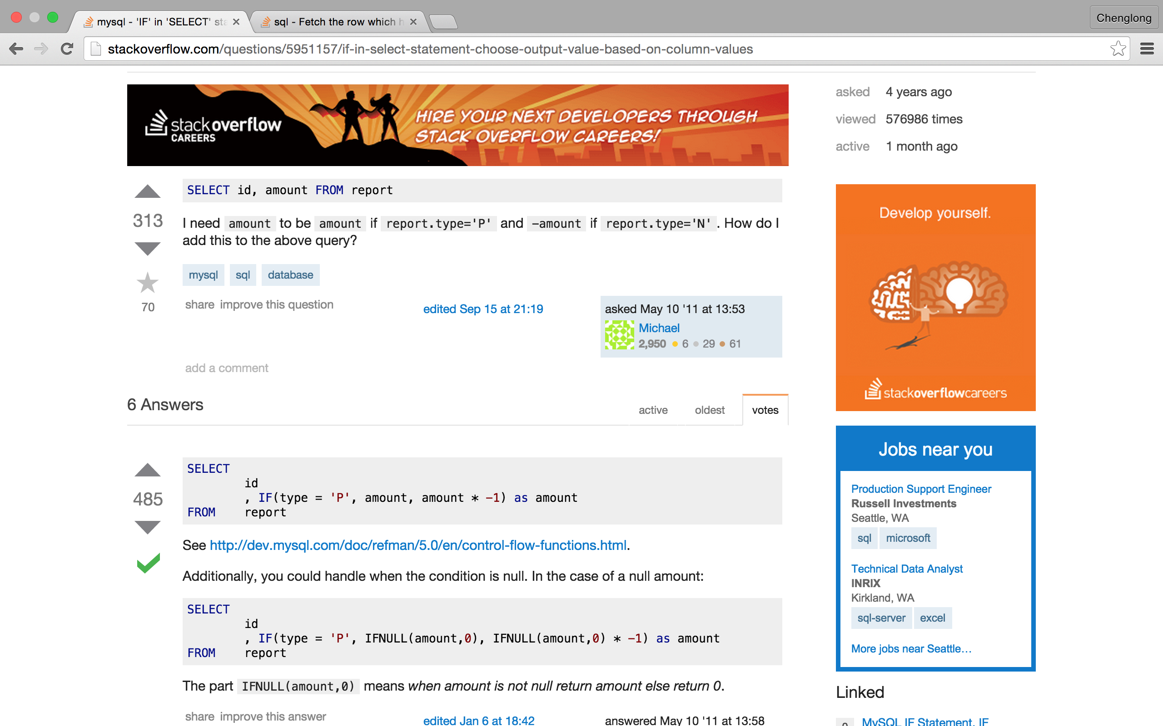
http://stackoverflow.com/questions/5951157/if-in-select-statement-choose-output-value-based-on-column-values

Slide 30
Select random row

Slide 31
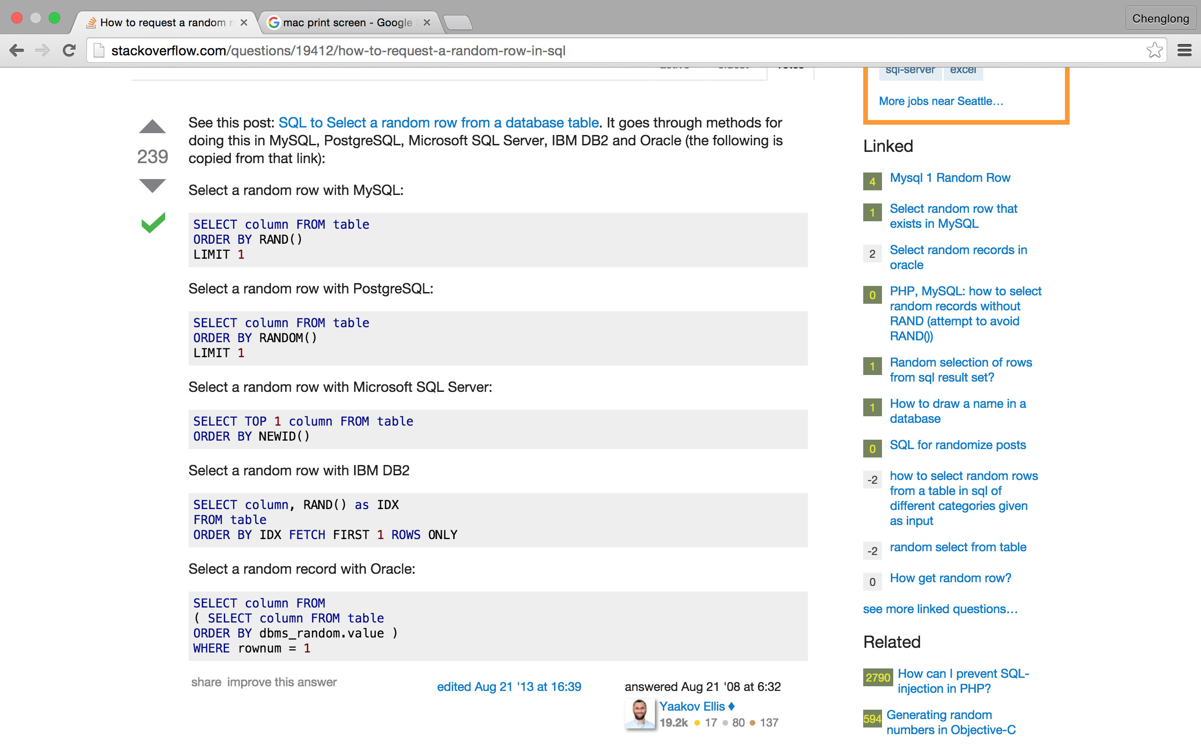
http://stackoverflow.com/questions/19412/how-to-request-a-random-row-in-sql

Slide 32
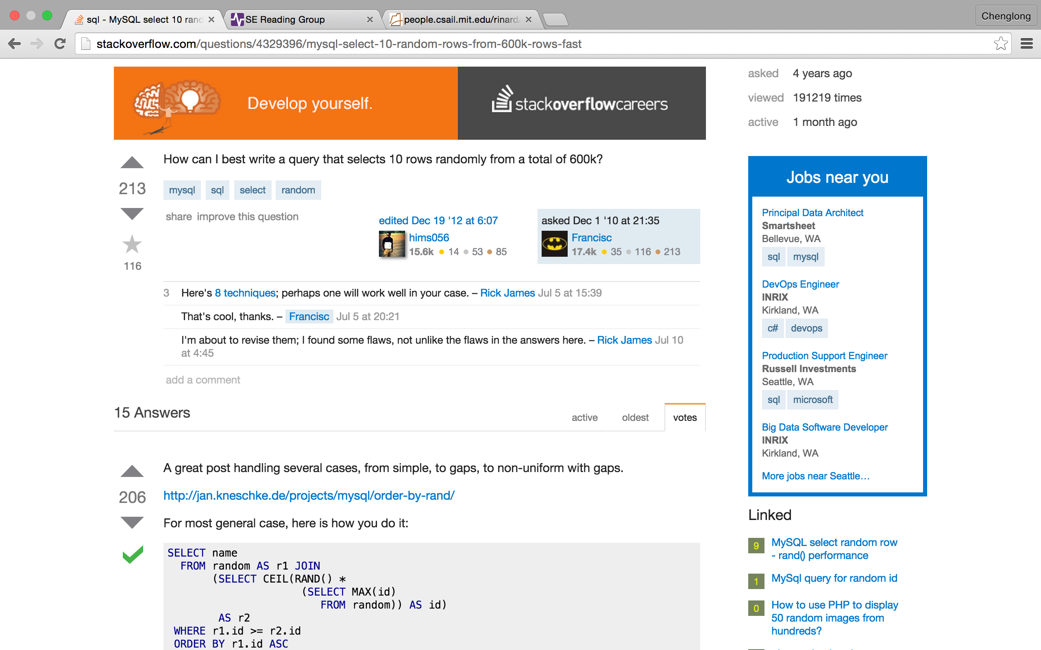
http://stackoverflow.com/questions/4329396/mysql-select-10-random-rows-from-600k-rows-fast

Slide 33
Argmax

Slide 34
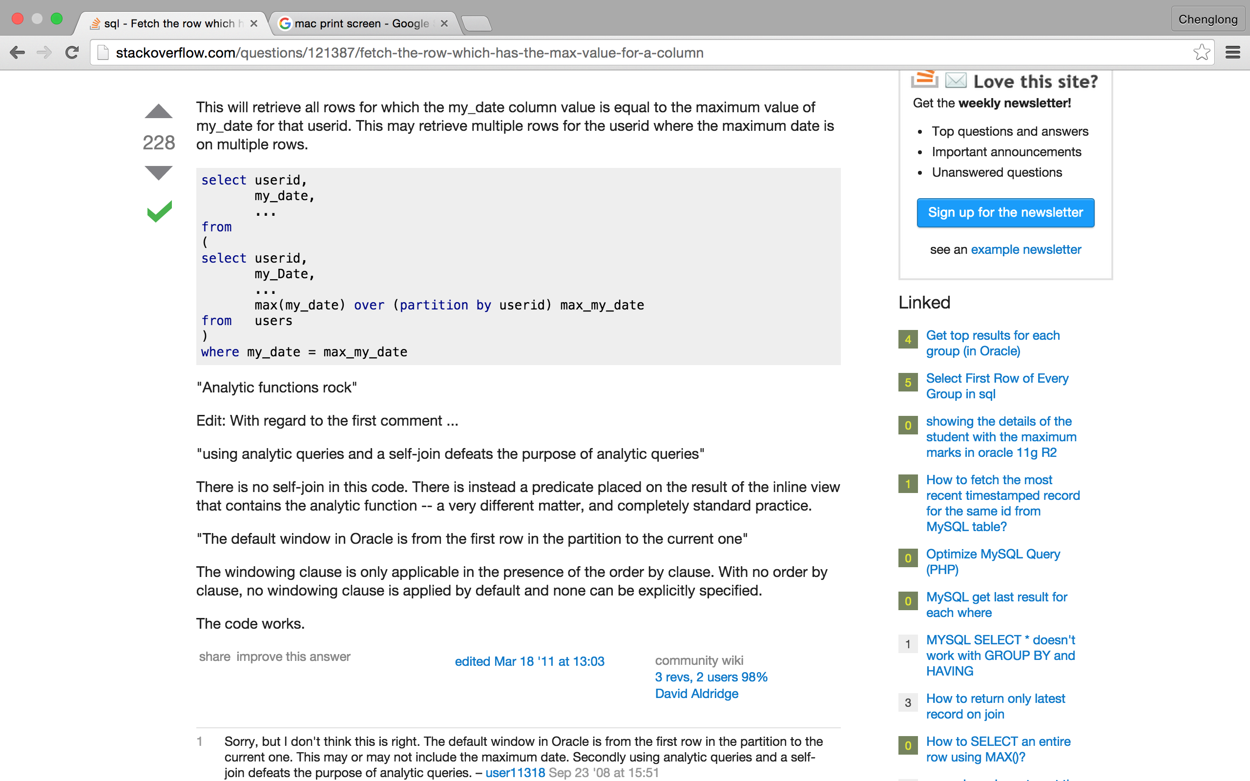
http://stackoverflow.com/questions/121387/fetch-the-row-which-has-the-max-value-for-a-column

Slide 35
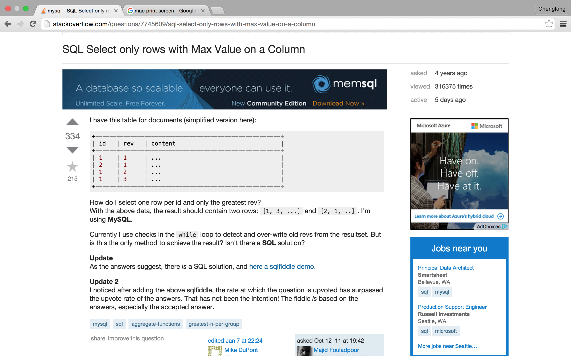
http://stackoverflow.com/questions/7745609/sql-select-only-rows-with-max-value-on-a-column

Slide 36
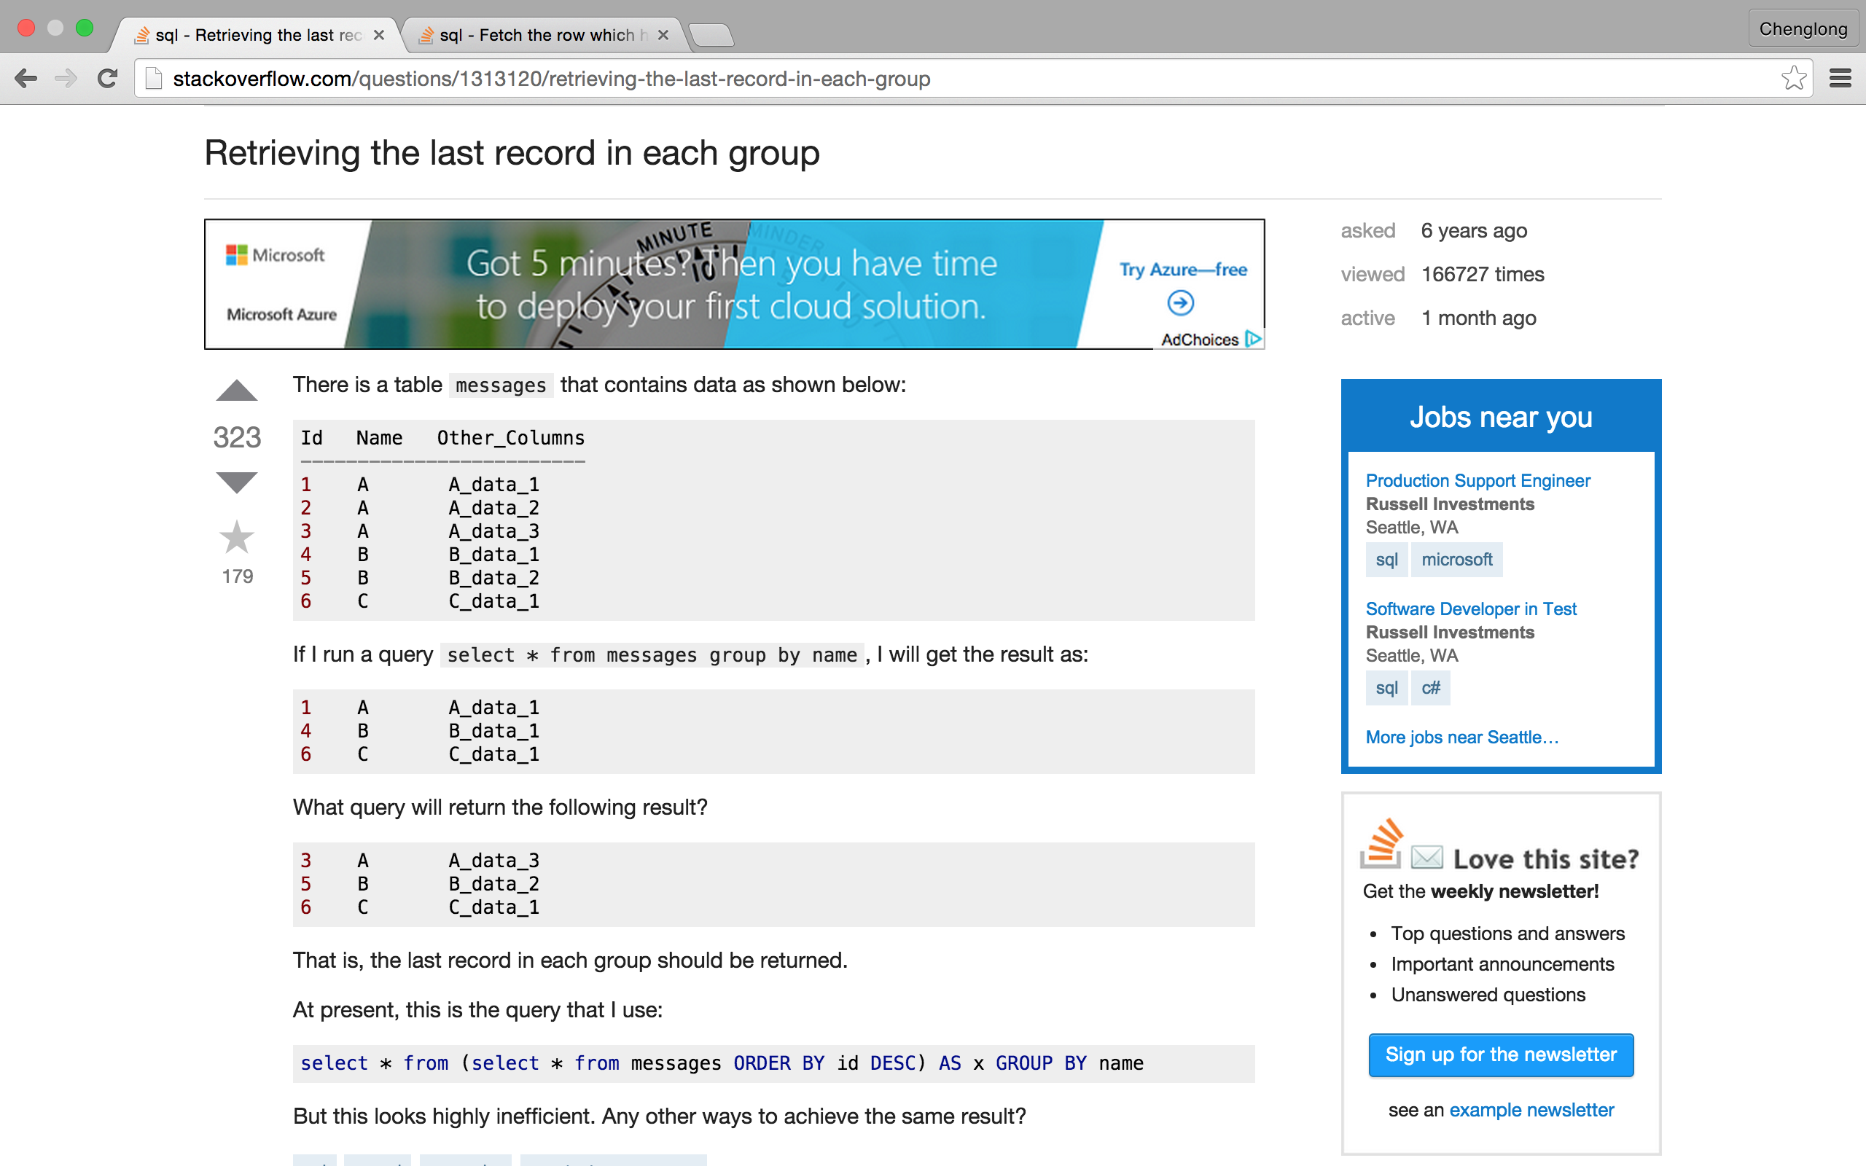
http://stackoverflow.com/questions/1313120/retrieving-the-last-record-in-each-group

Slide 37
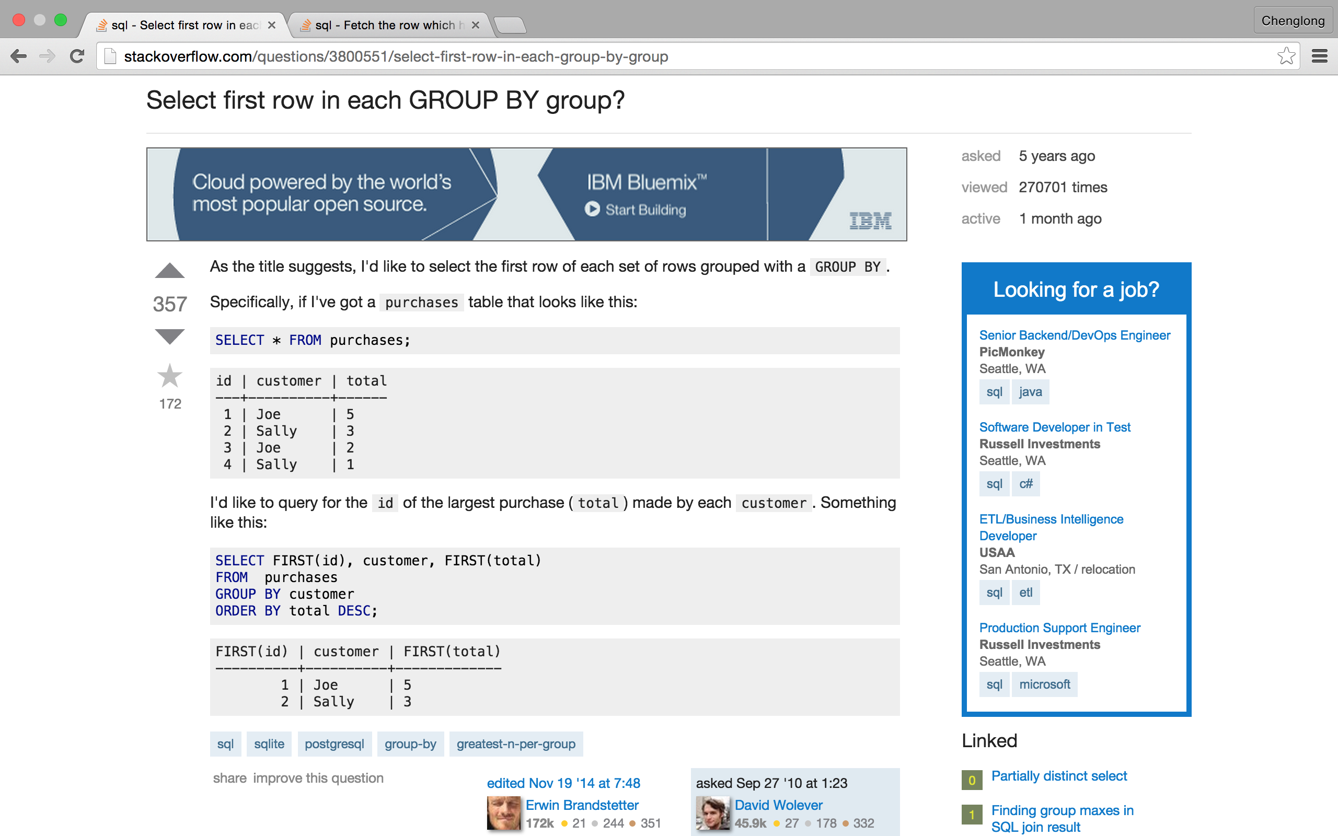
http://stackoverflow.com/questions/3800551/select-first-row-in-each-group-by-group

Slide 38
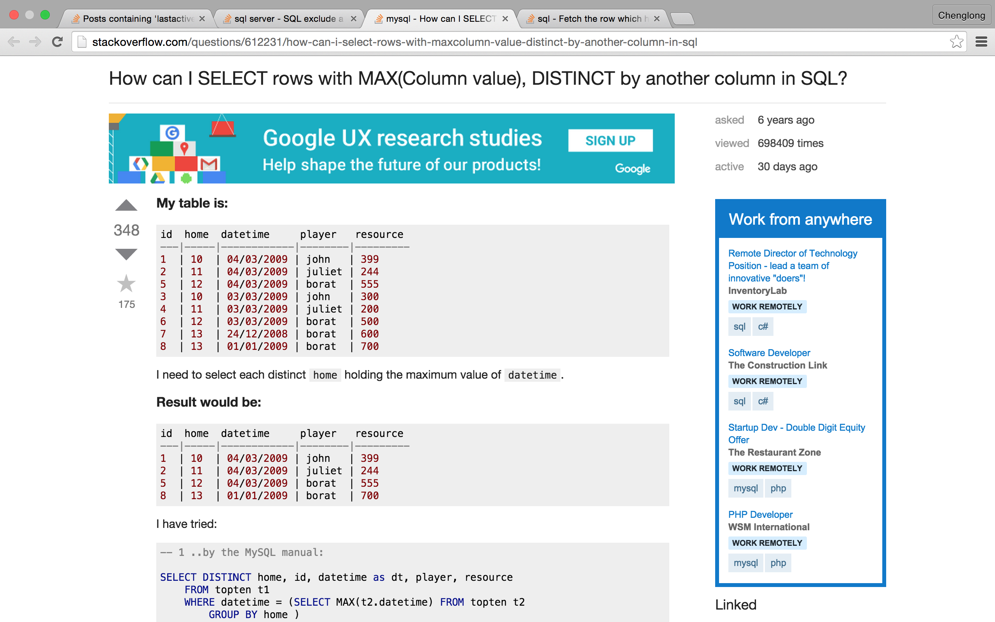
http://stackoverflow.com/questions/612231/how-can-i-select-rows-with-maxcolumn-value-distinct-by-another-column-in-sql

Slide 39
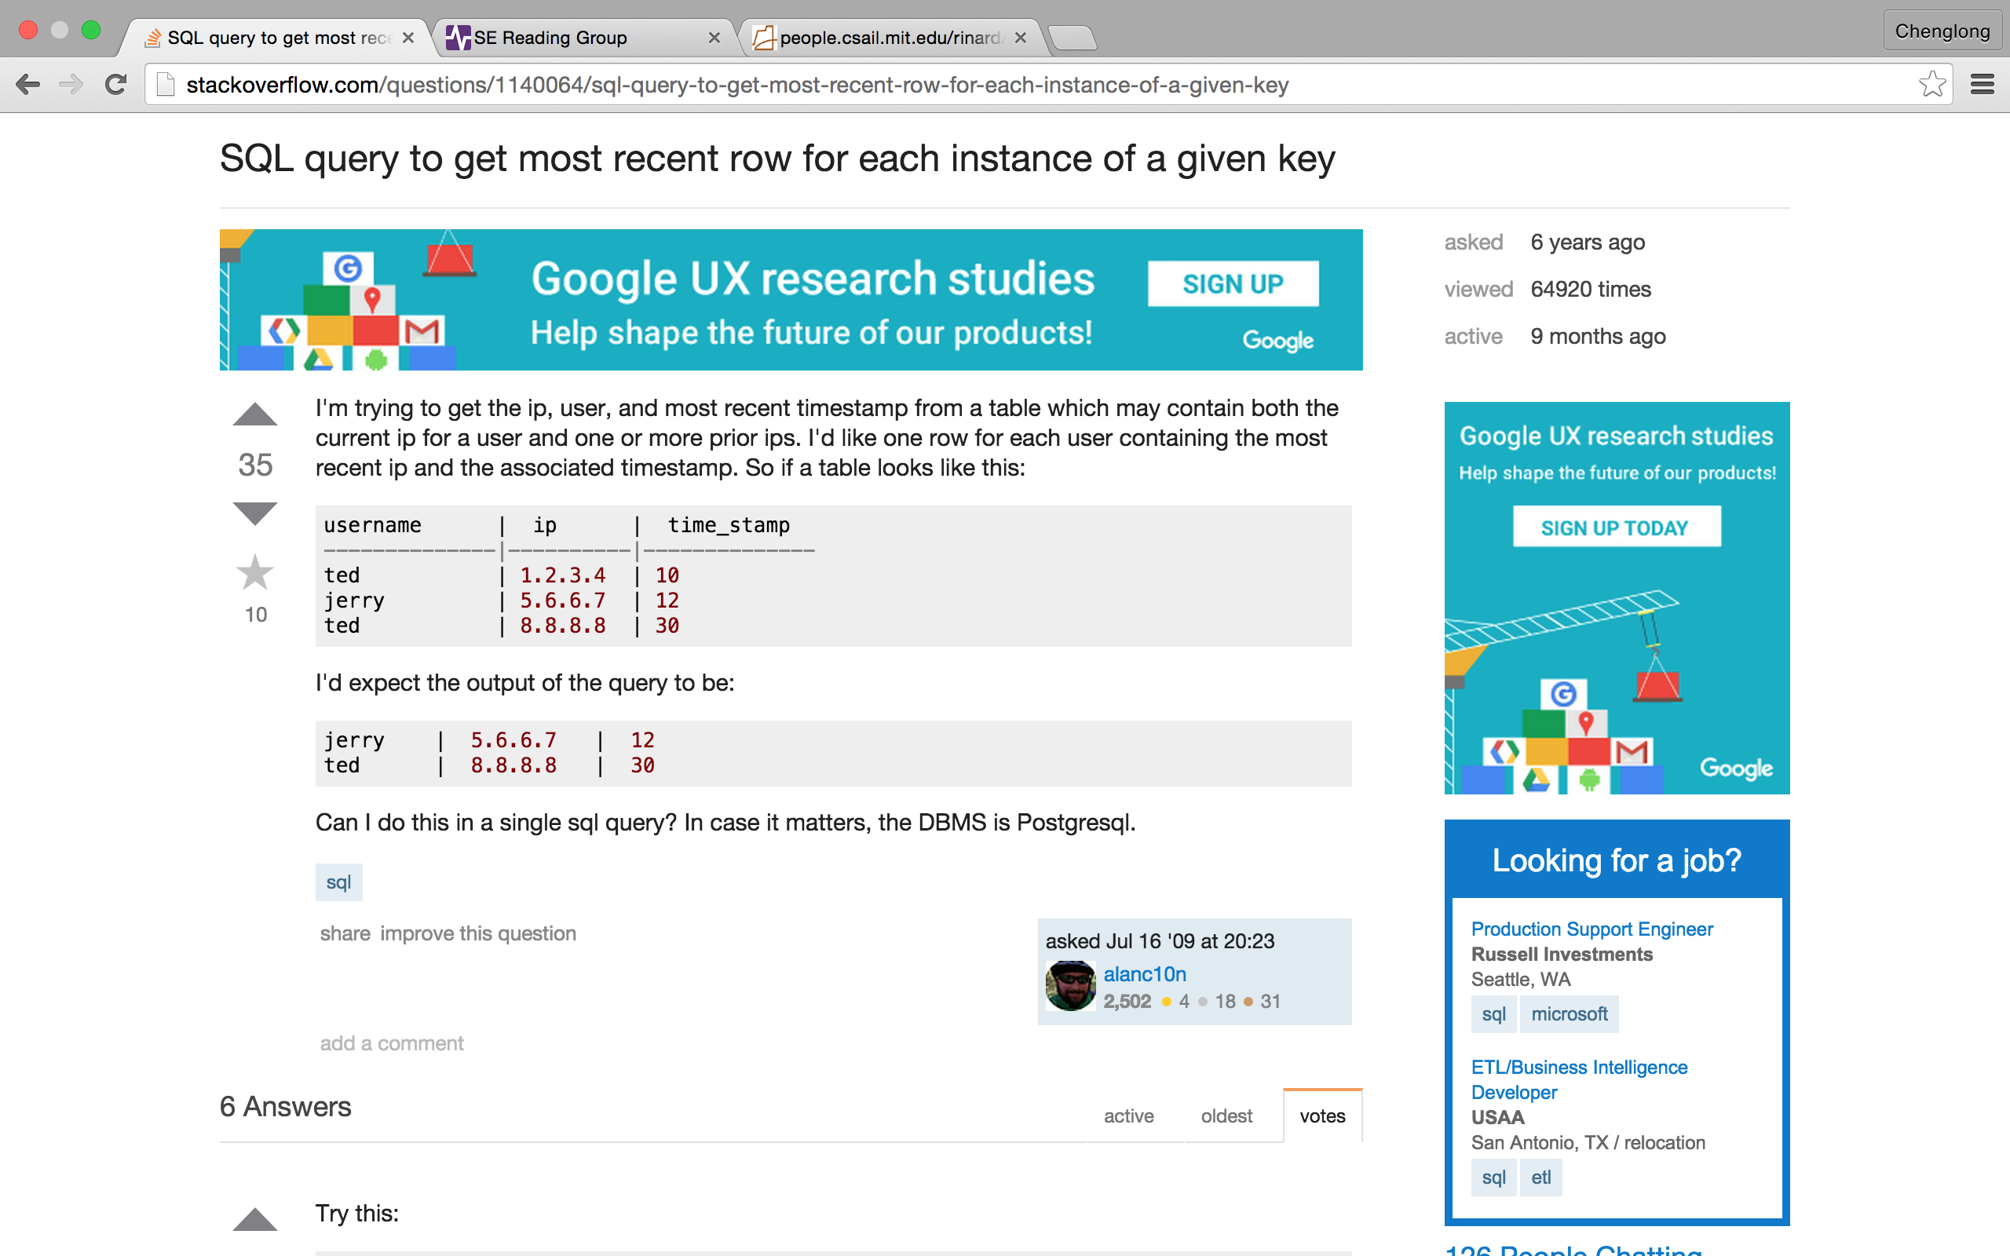
http://stackoverflow.com/questions/1140064/sql-query-to-get-most-recent-row-for-each-instance-of-a-given-key

Slide 40
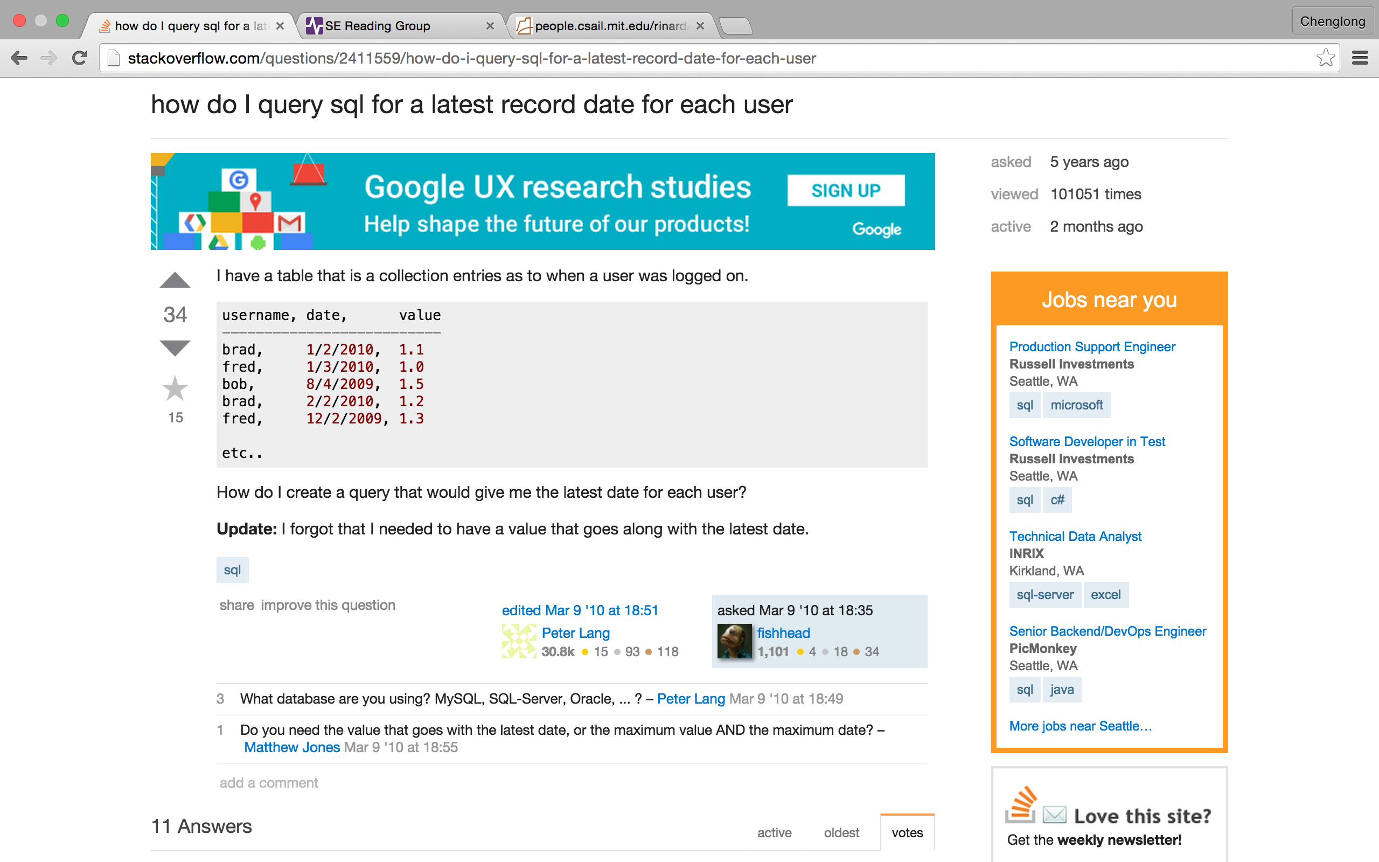
http://stackoverflow.com/questions/2411559/how-do-i-query-sql-for-a-latest-record-date-for-each-user

Slide 41
Subquery

Slide 42
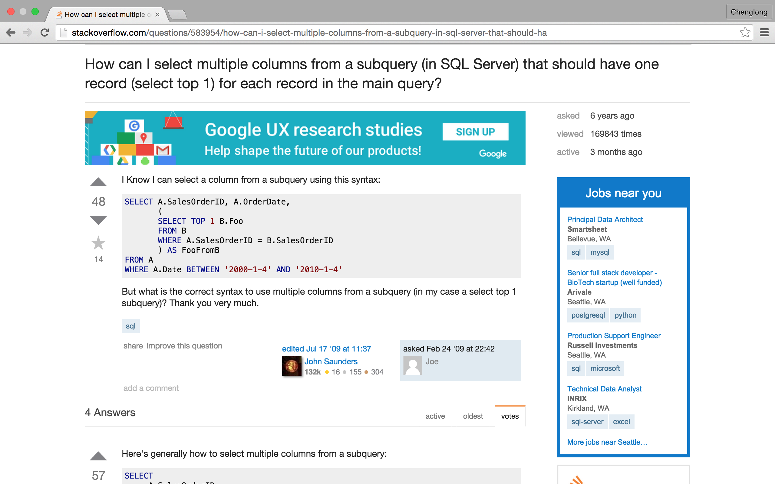
http://stackoverflow.com/questions/583954/how-can-i-select-multiple-columns-from-a-subquery-in-sql-server-that-should-ha

Slide 43
Select n-th row

Slide 44
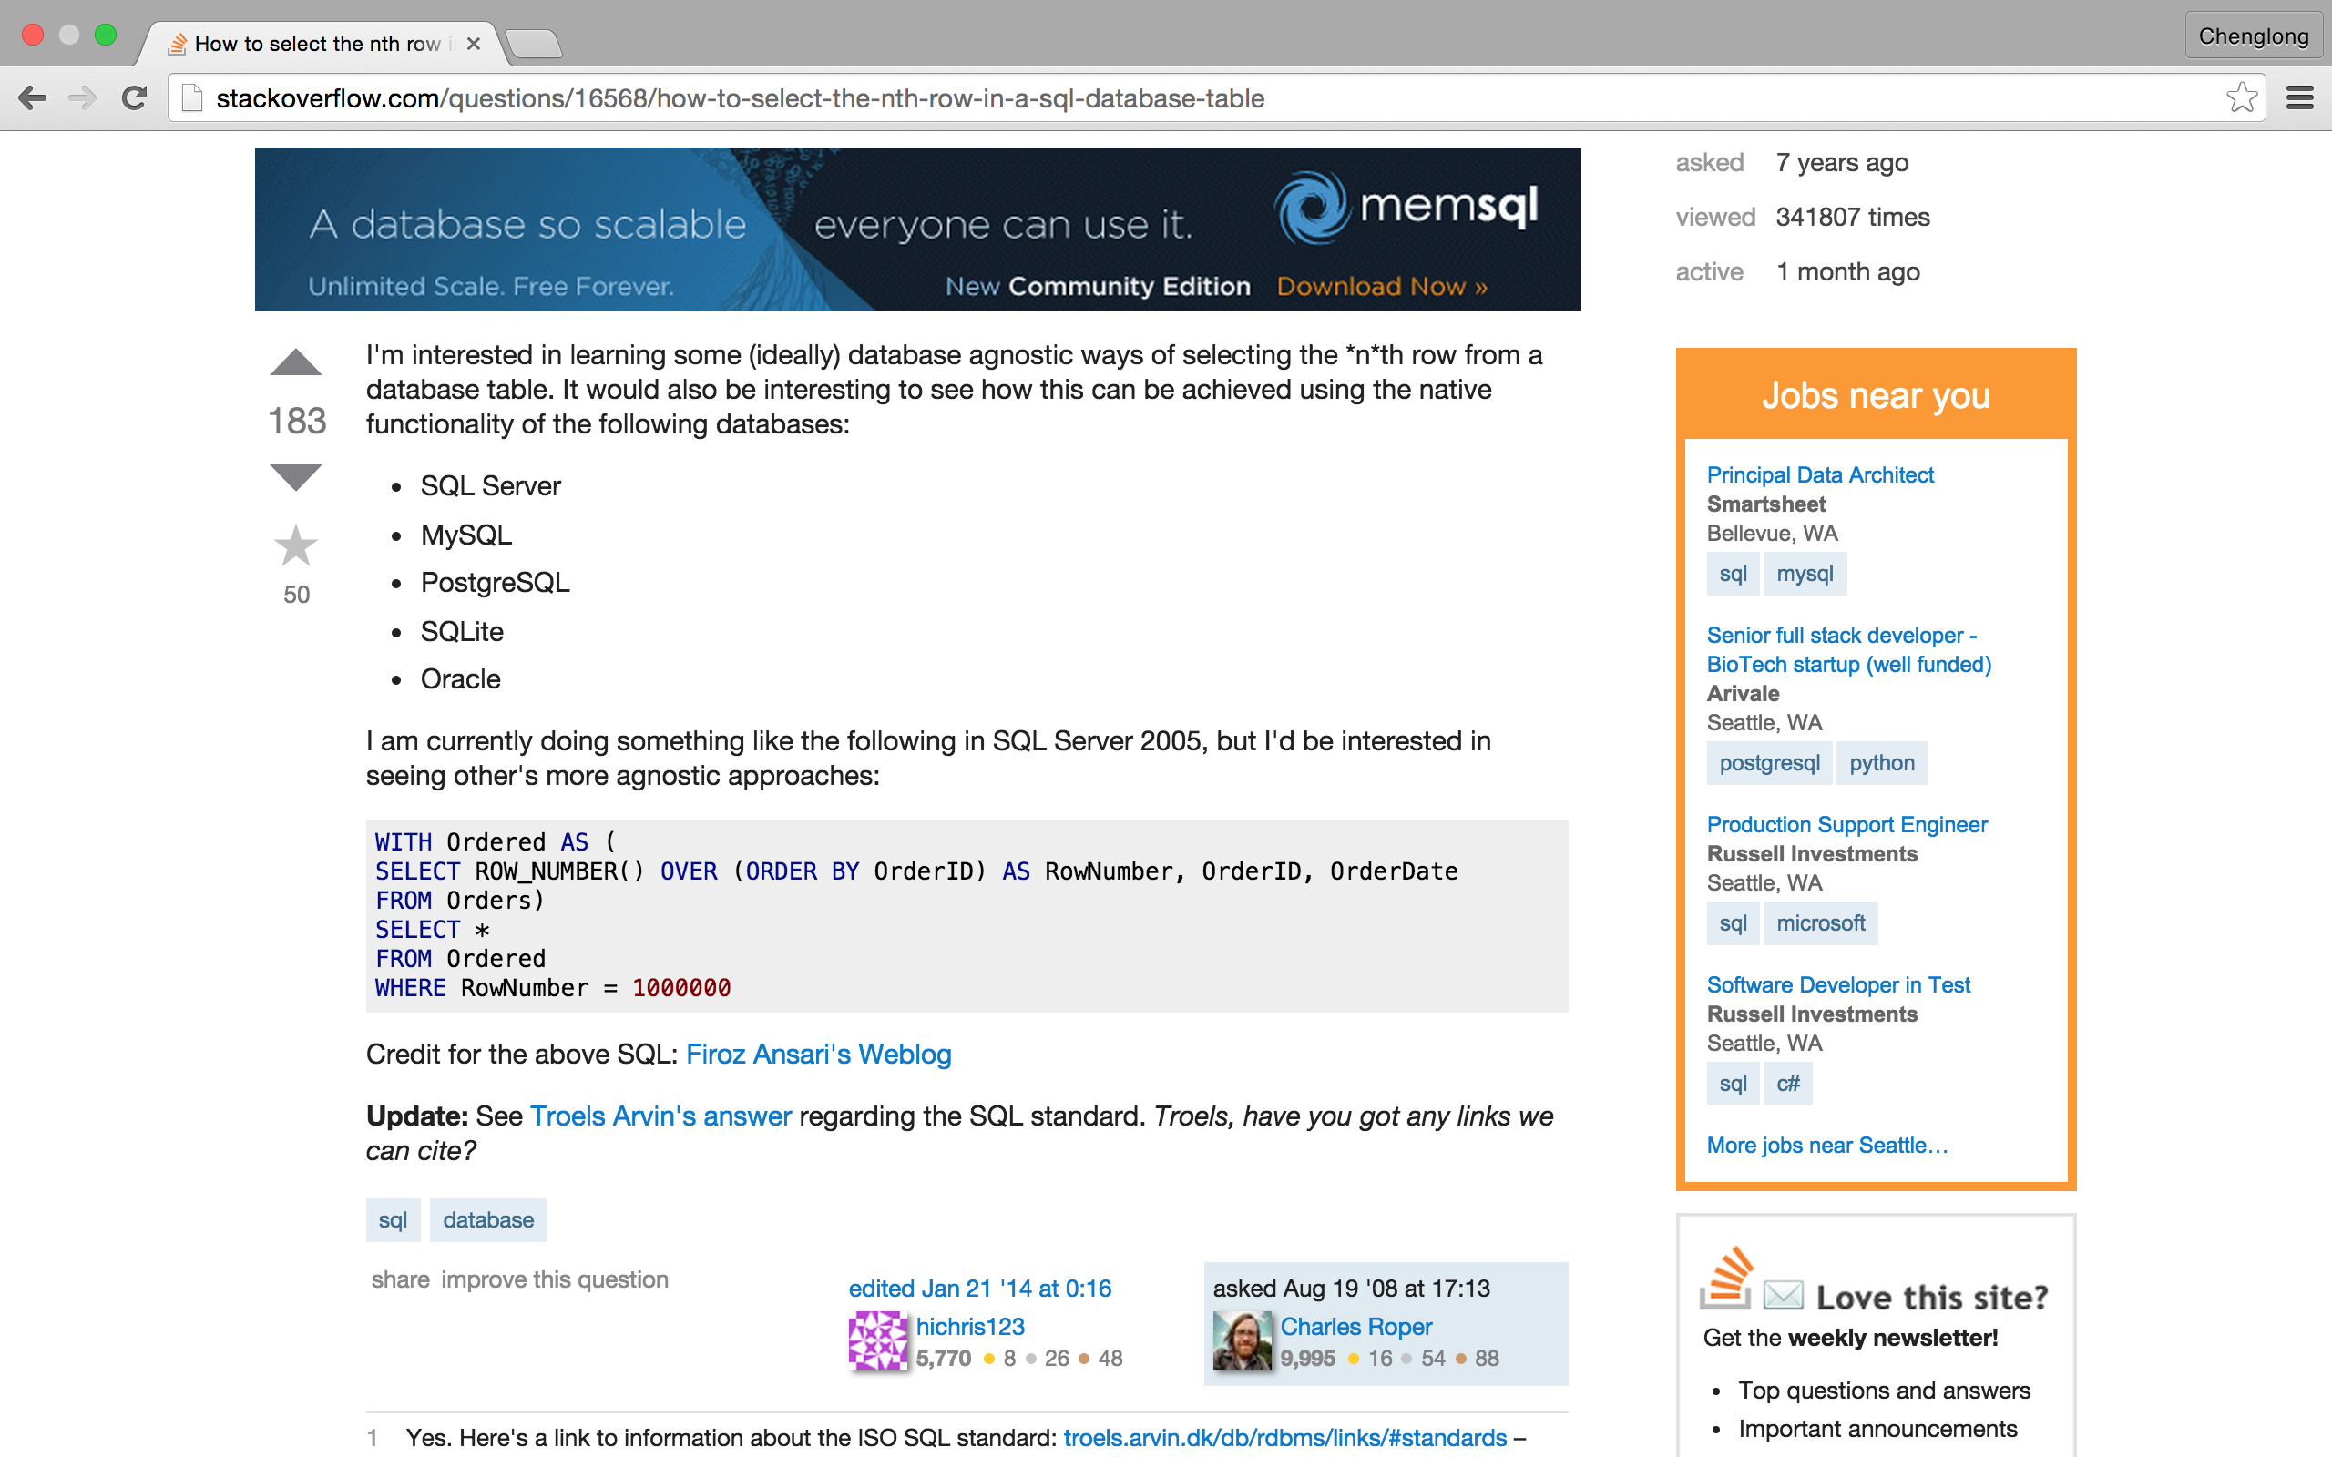
http://stackoverflow.com/questions/16568/how-to-select-the-nth-row-in-a-sql-database-table

Slide 45
Count

Slide 46
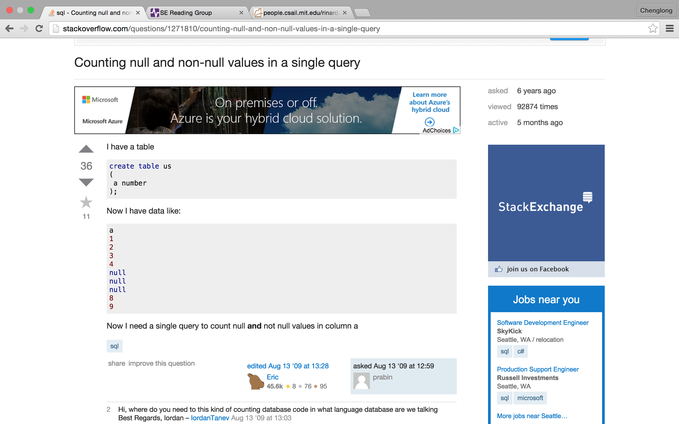
http://stackoverflow.com/questions/1271810/counting-null-and-non-null-values-in-a-single-query

Slide 47
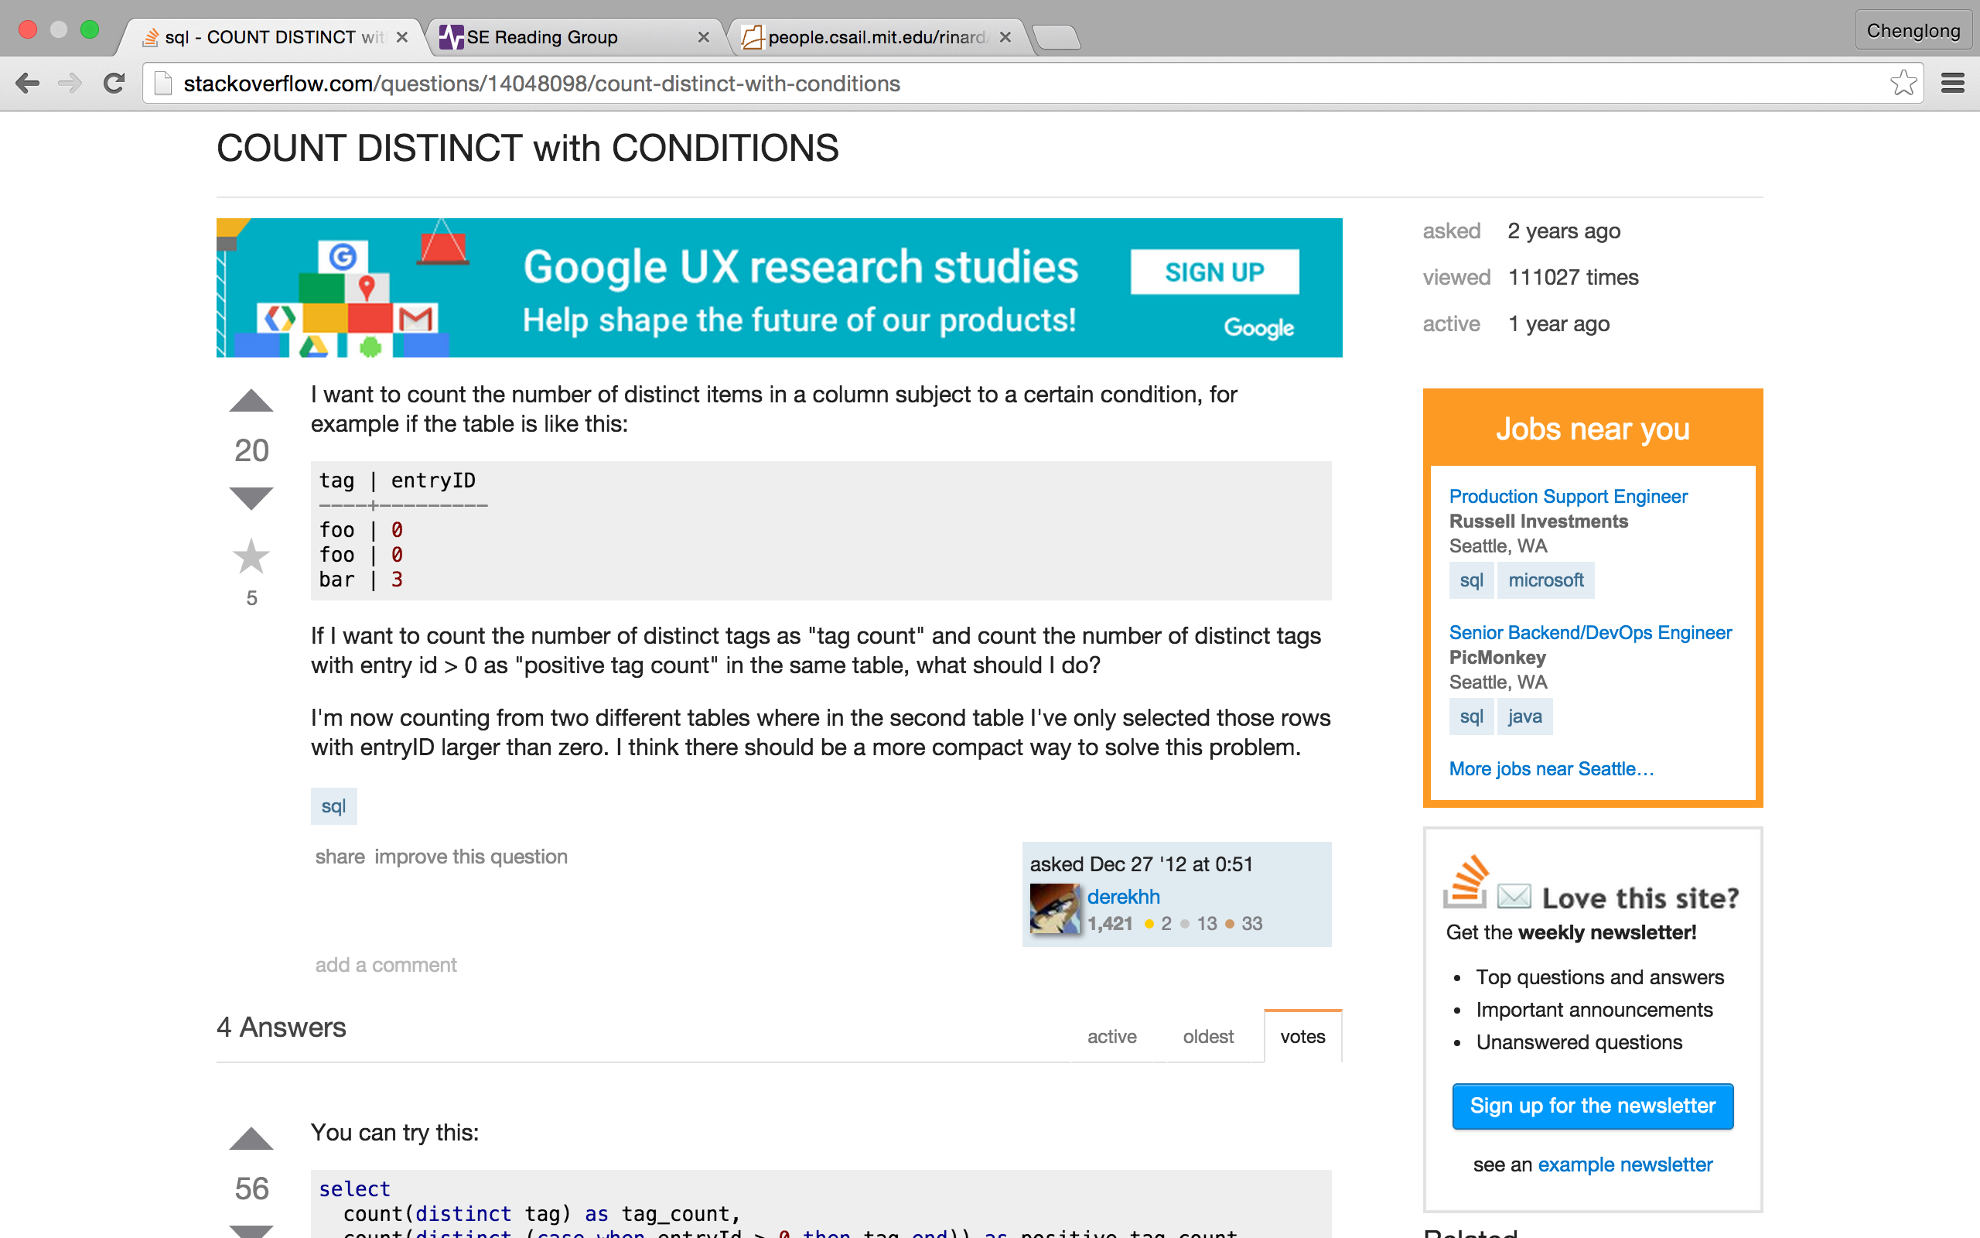
http://stackoverflow.com/questions/14048098/count-distinct-with-conditions

Slide 48
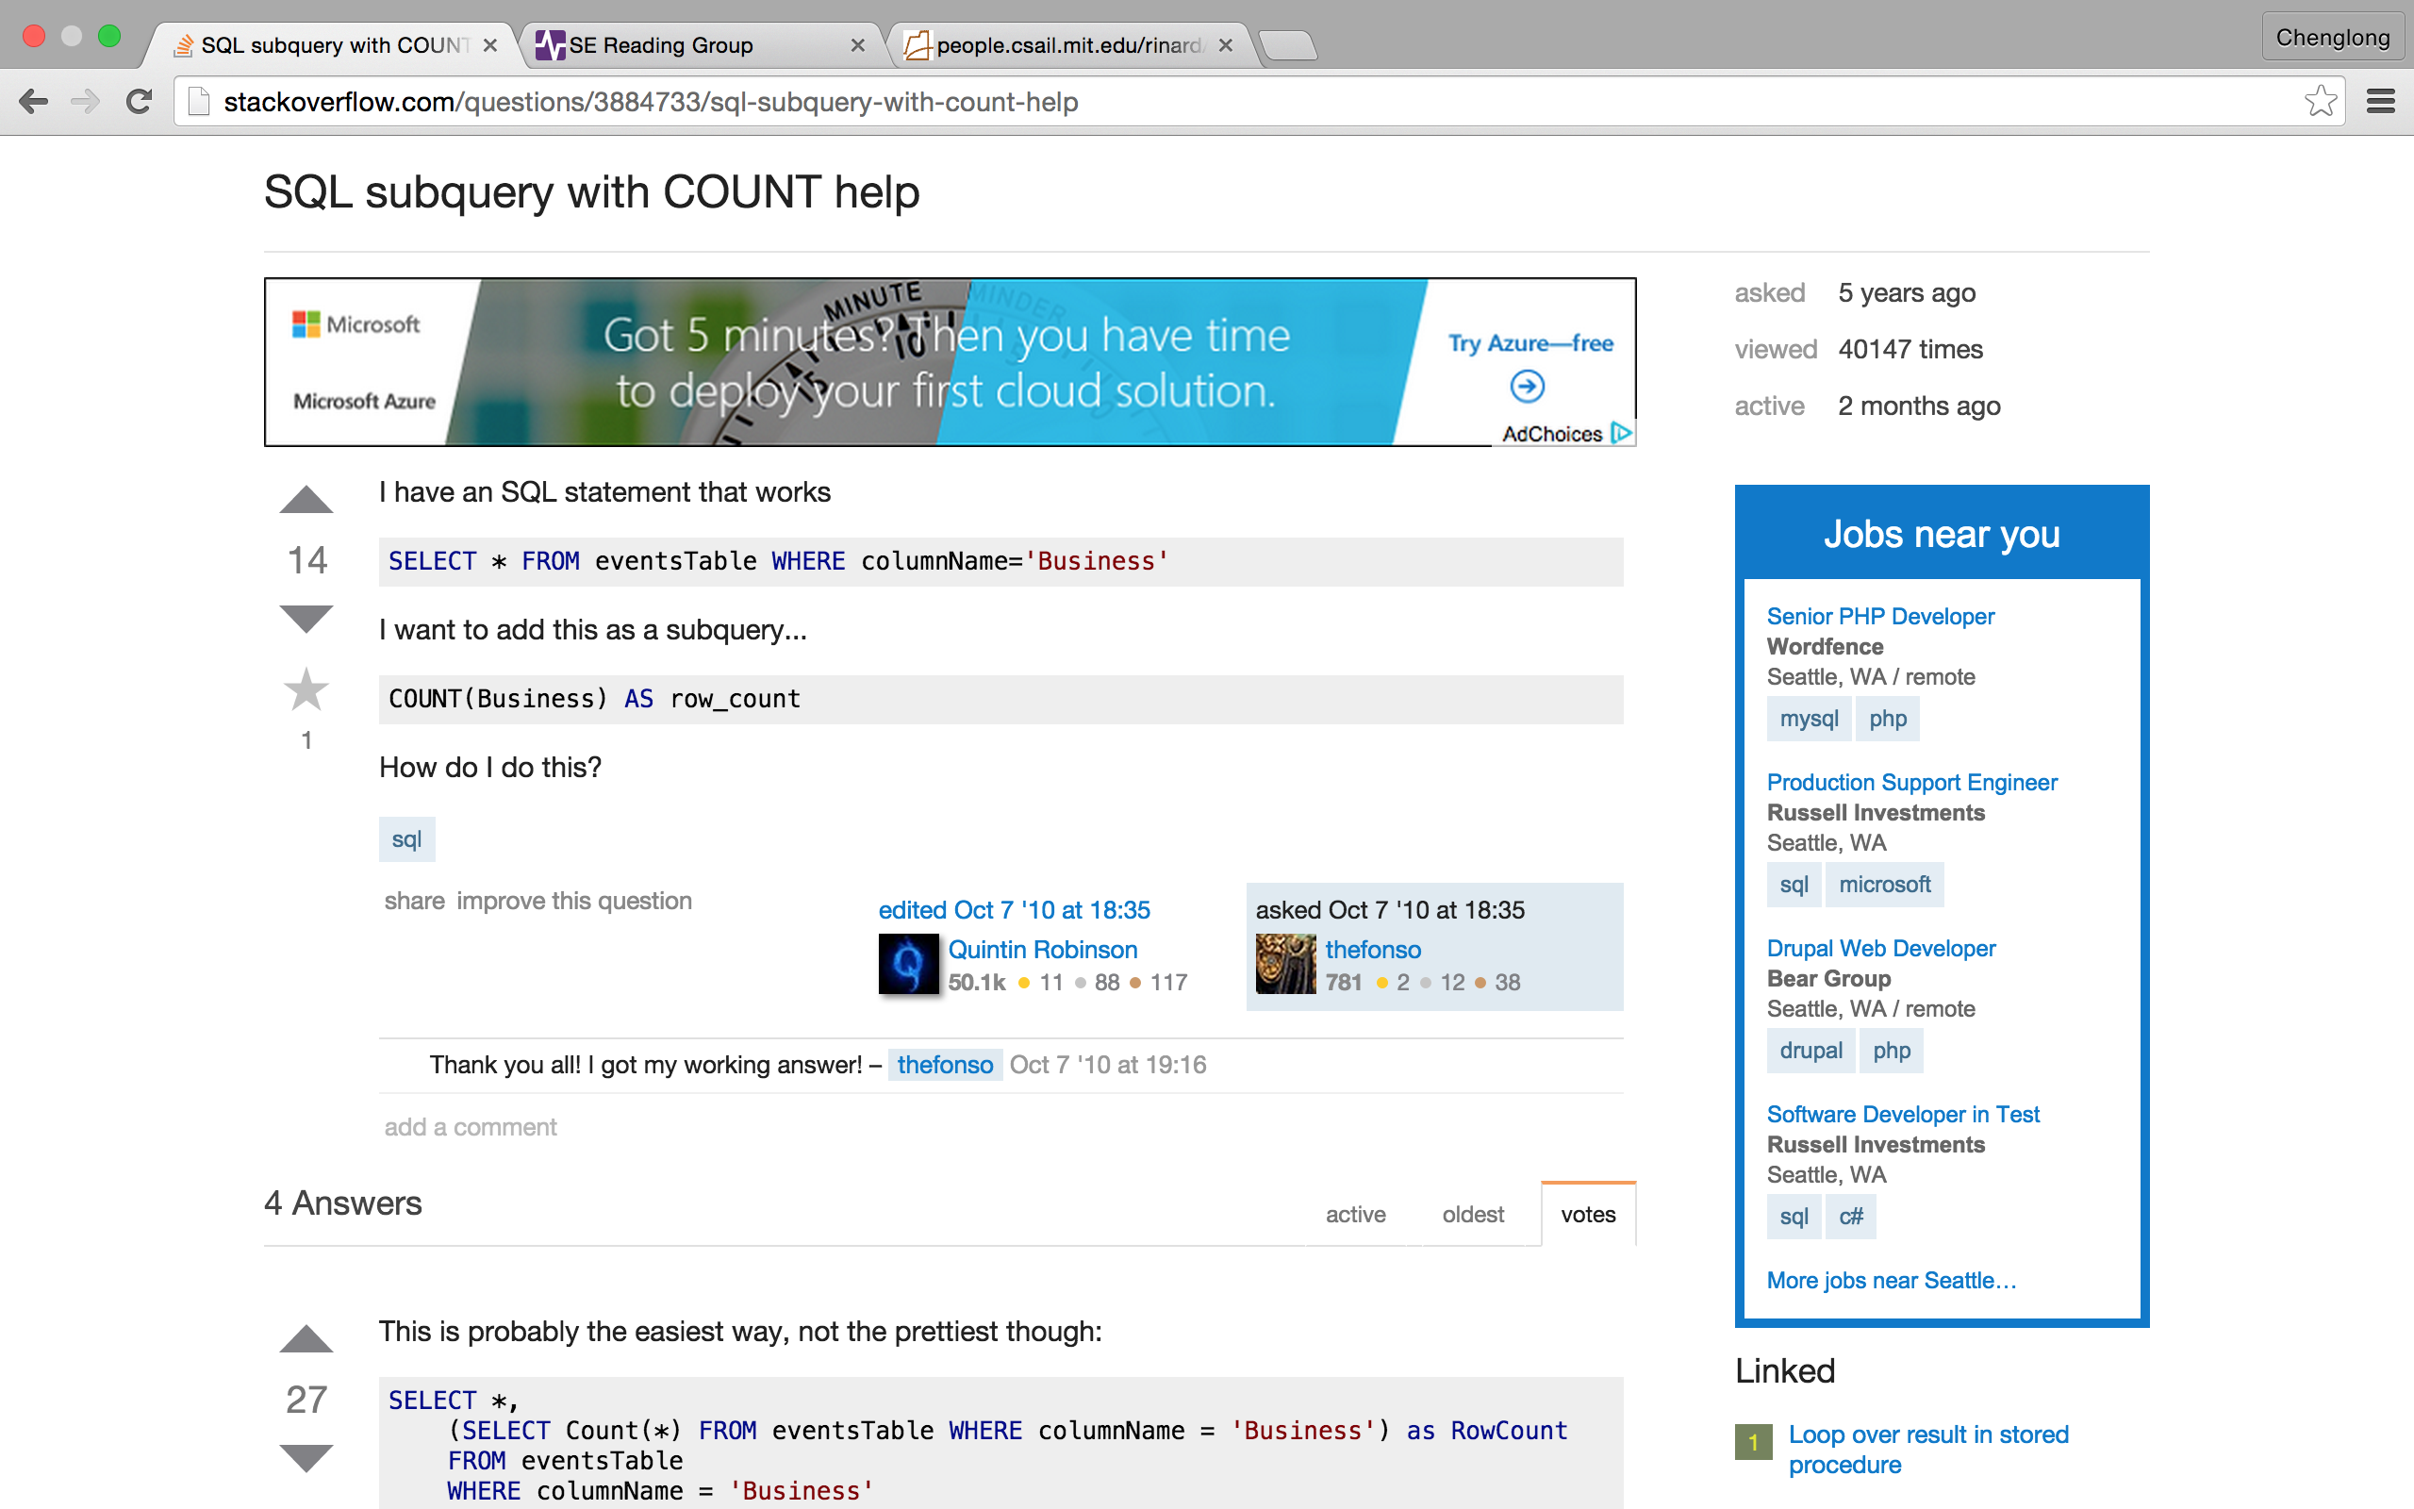
http://stackoverflow.com/questions/3884733/sql-subquery-with-count-help

Slide 49
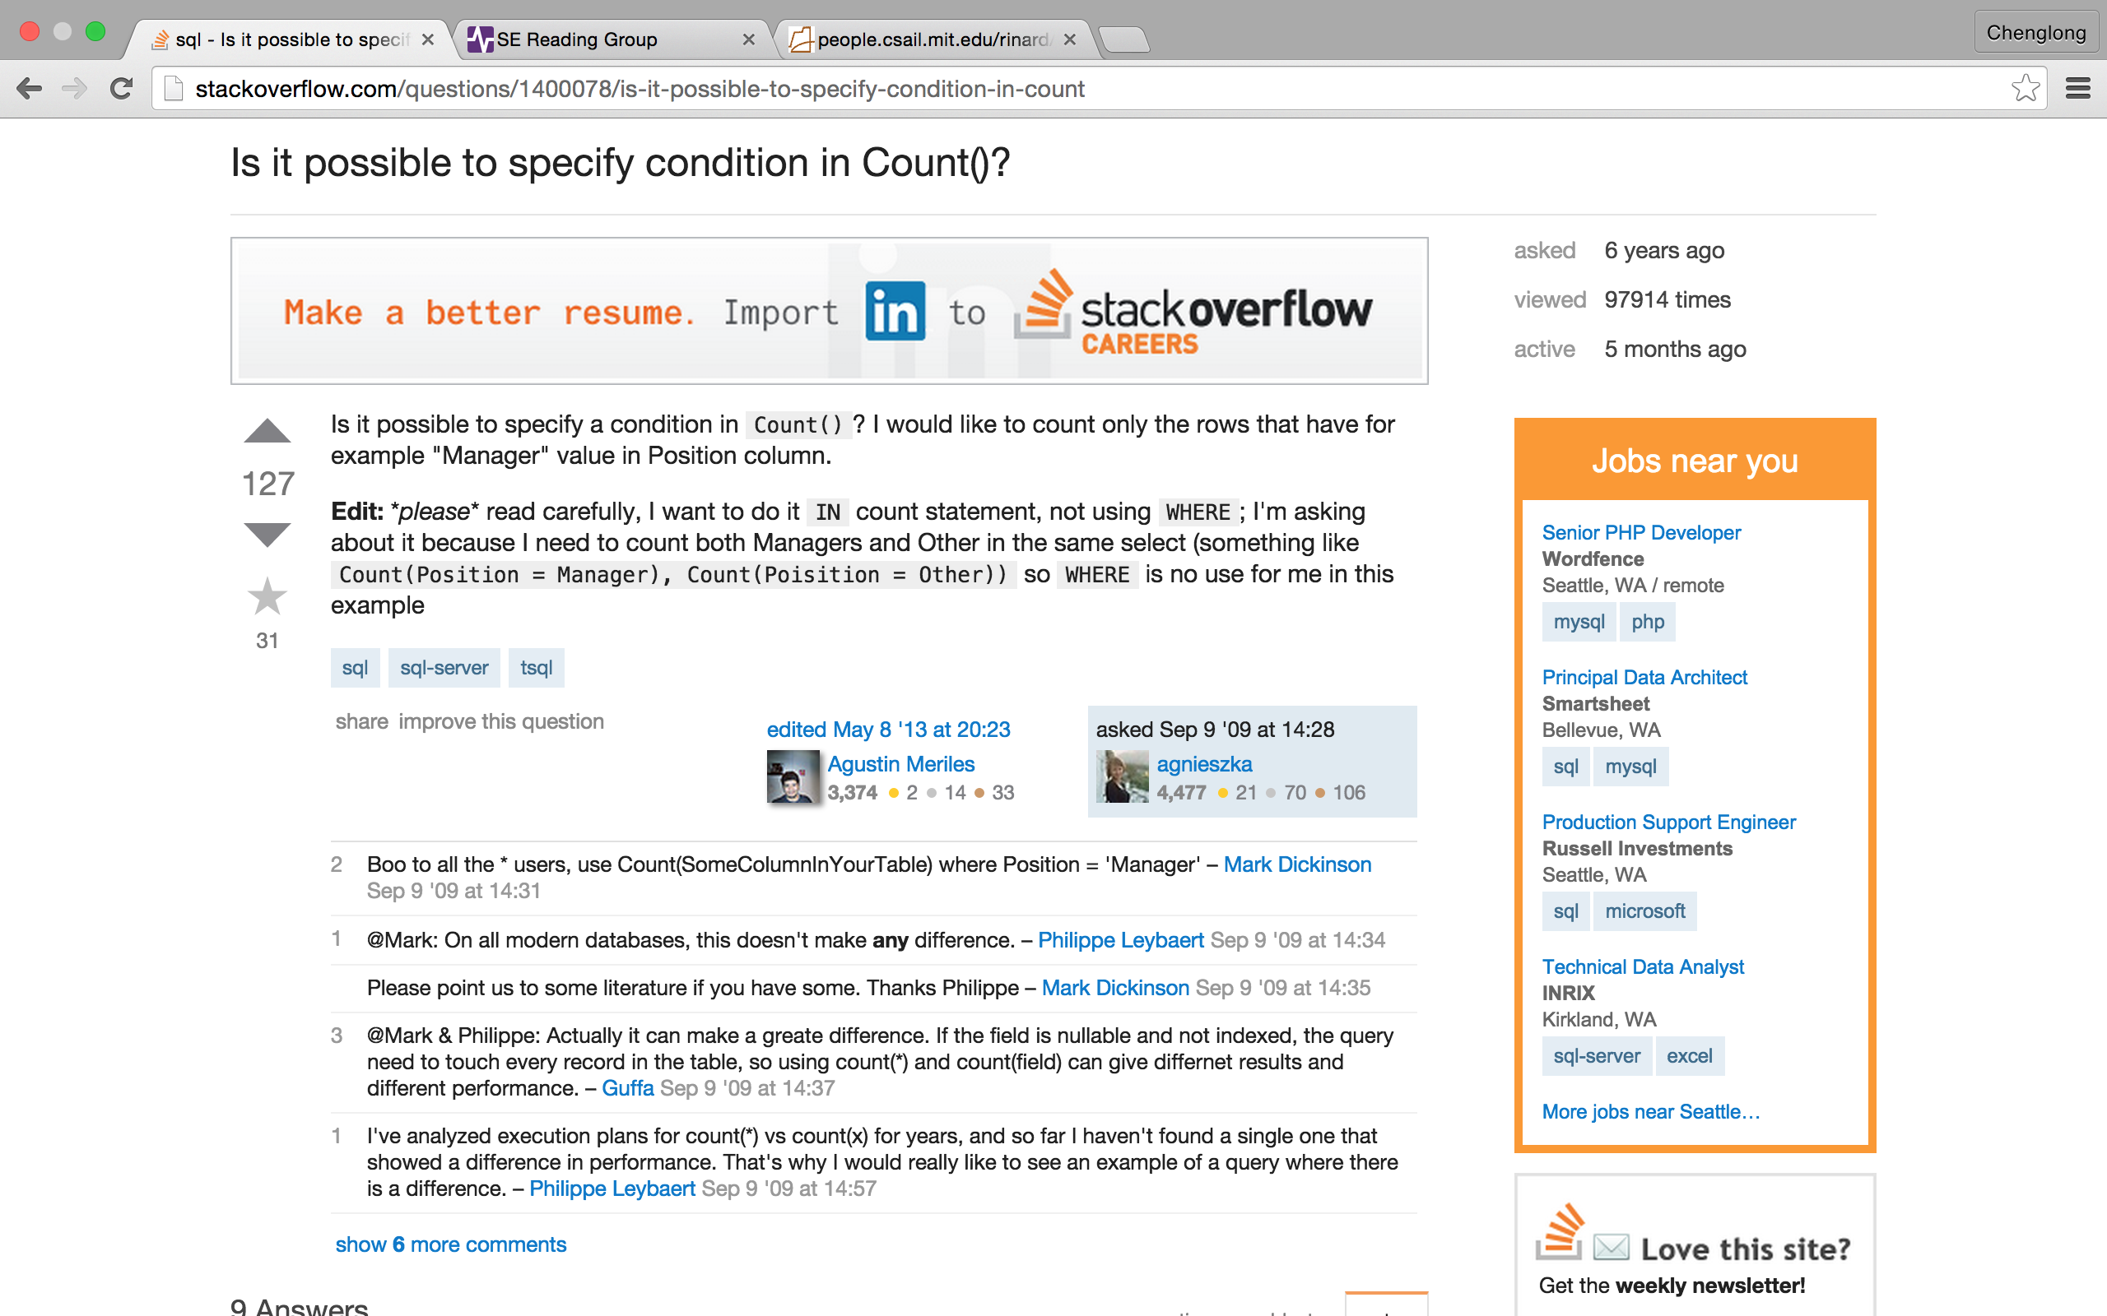
http://stackoverflow.com/questions/1400078/is-it-possible-to-specify-condition-in-count

Slide 50
Column-wise comparison

Slide 51
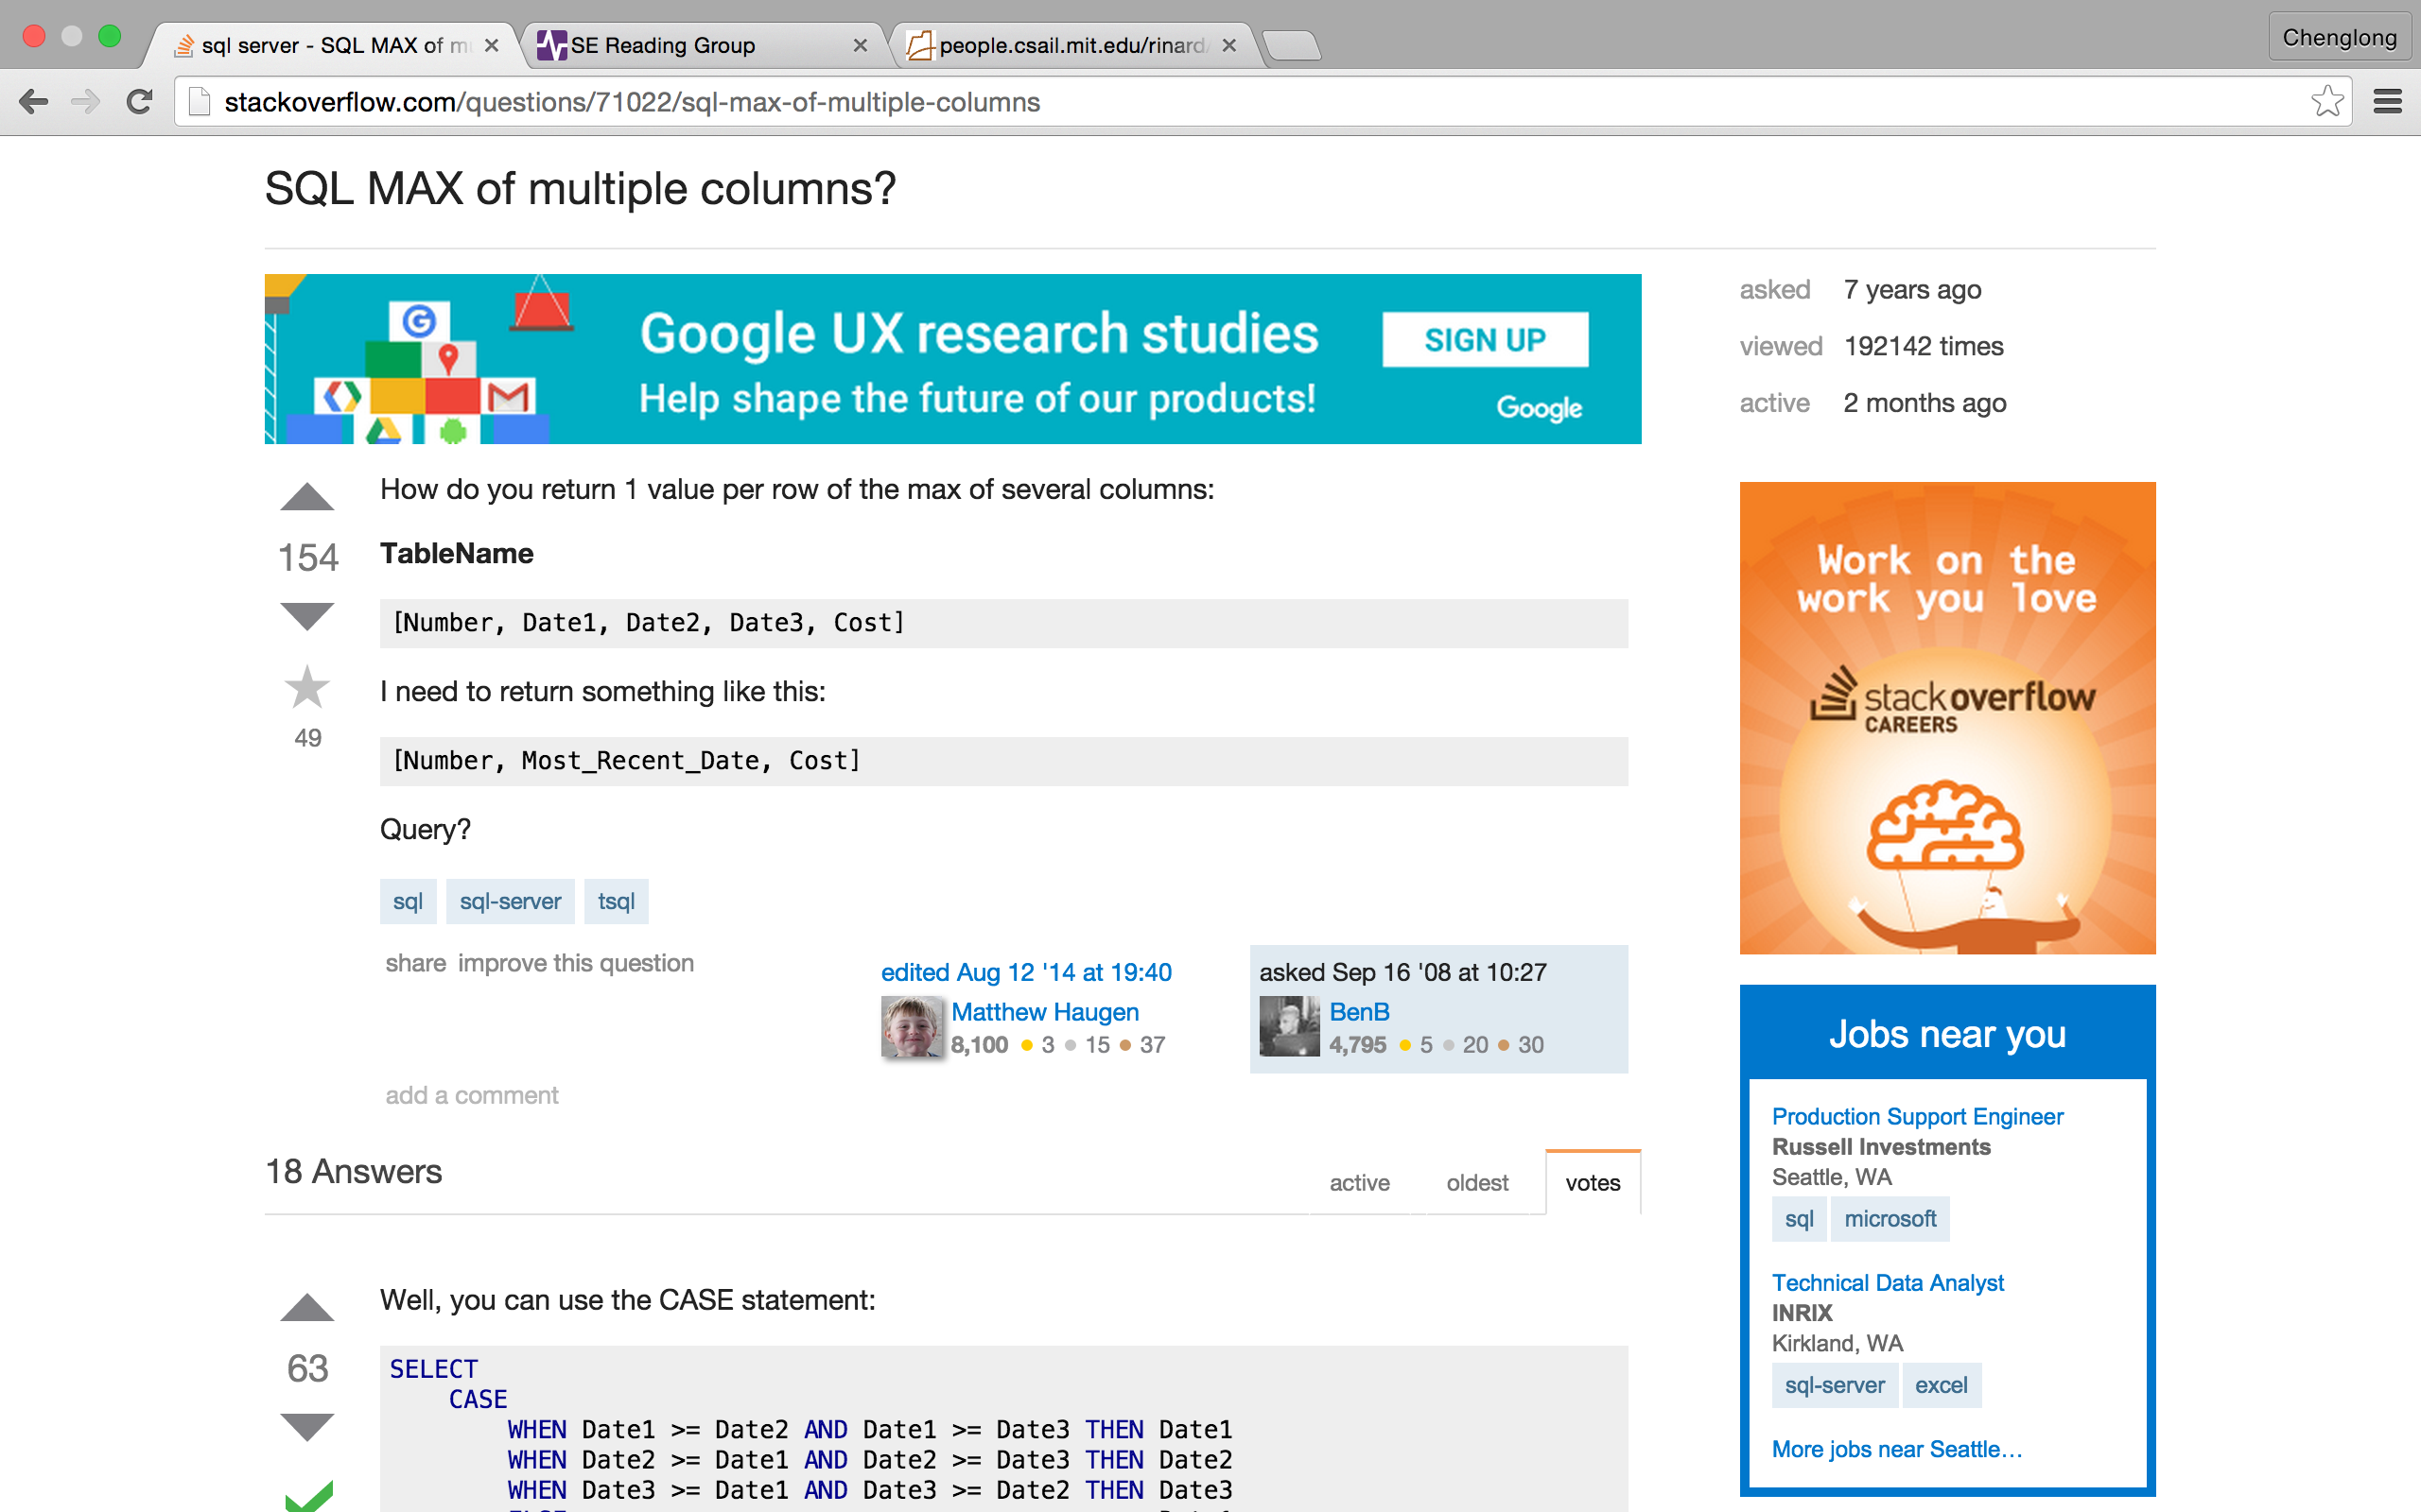
http://stackoverflow.com/questions/71022/sql-max-of-multiple-columns

Slide 52
Moving average

Slide 53
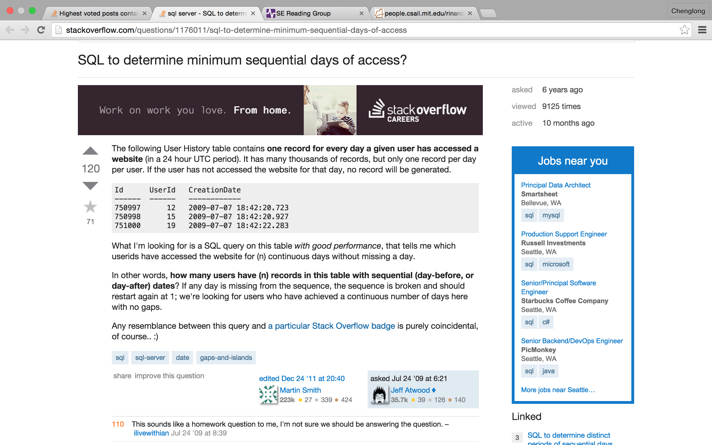
http://stackoverflow.com/questions/1176011/sql-to-determine-minimum-sequential-days-of-access

Slide 54
Calculate medium

Slide 55
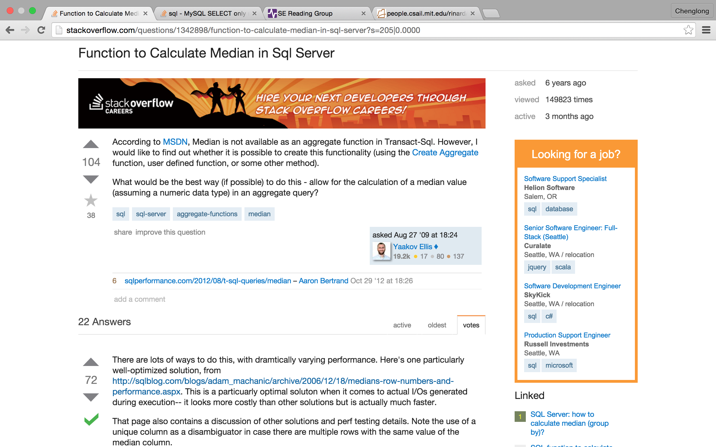

Slide 56
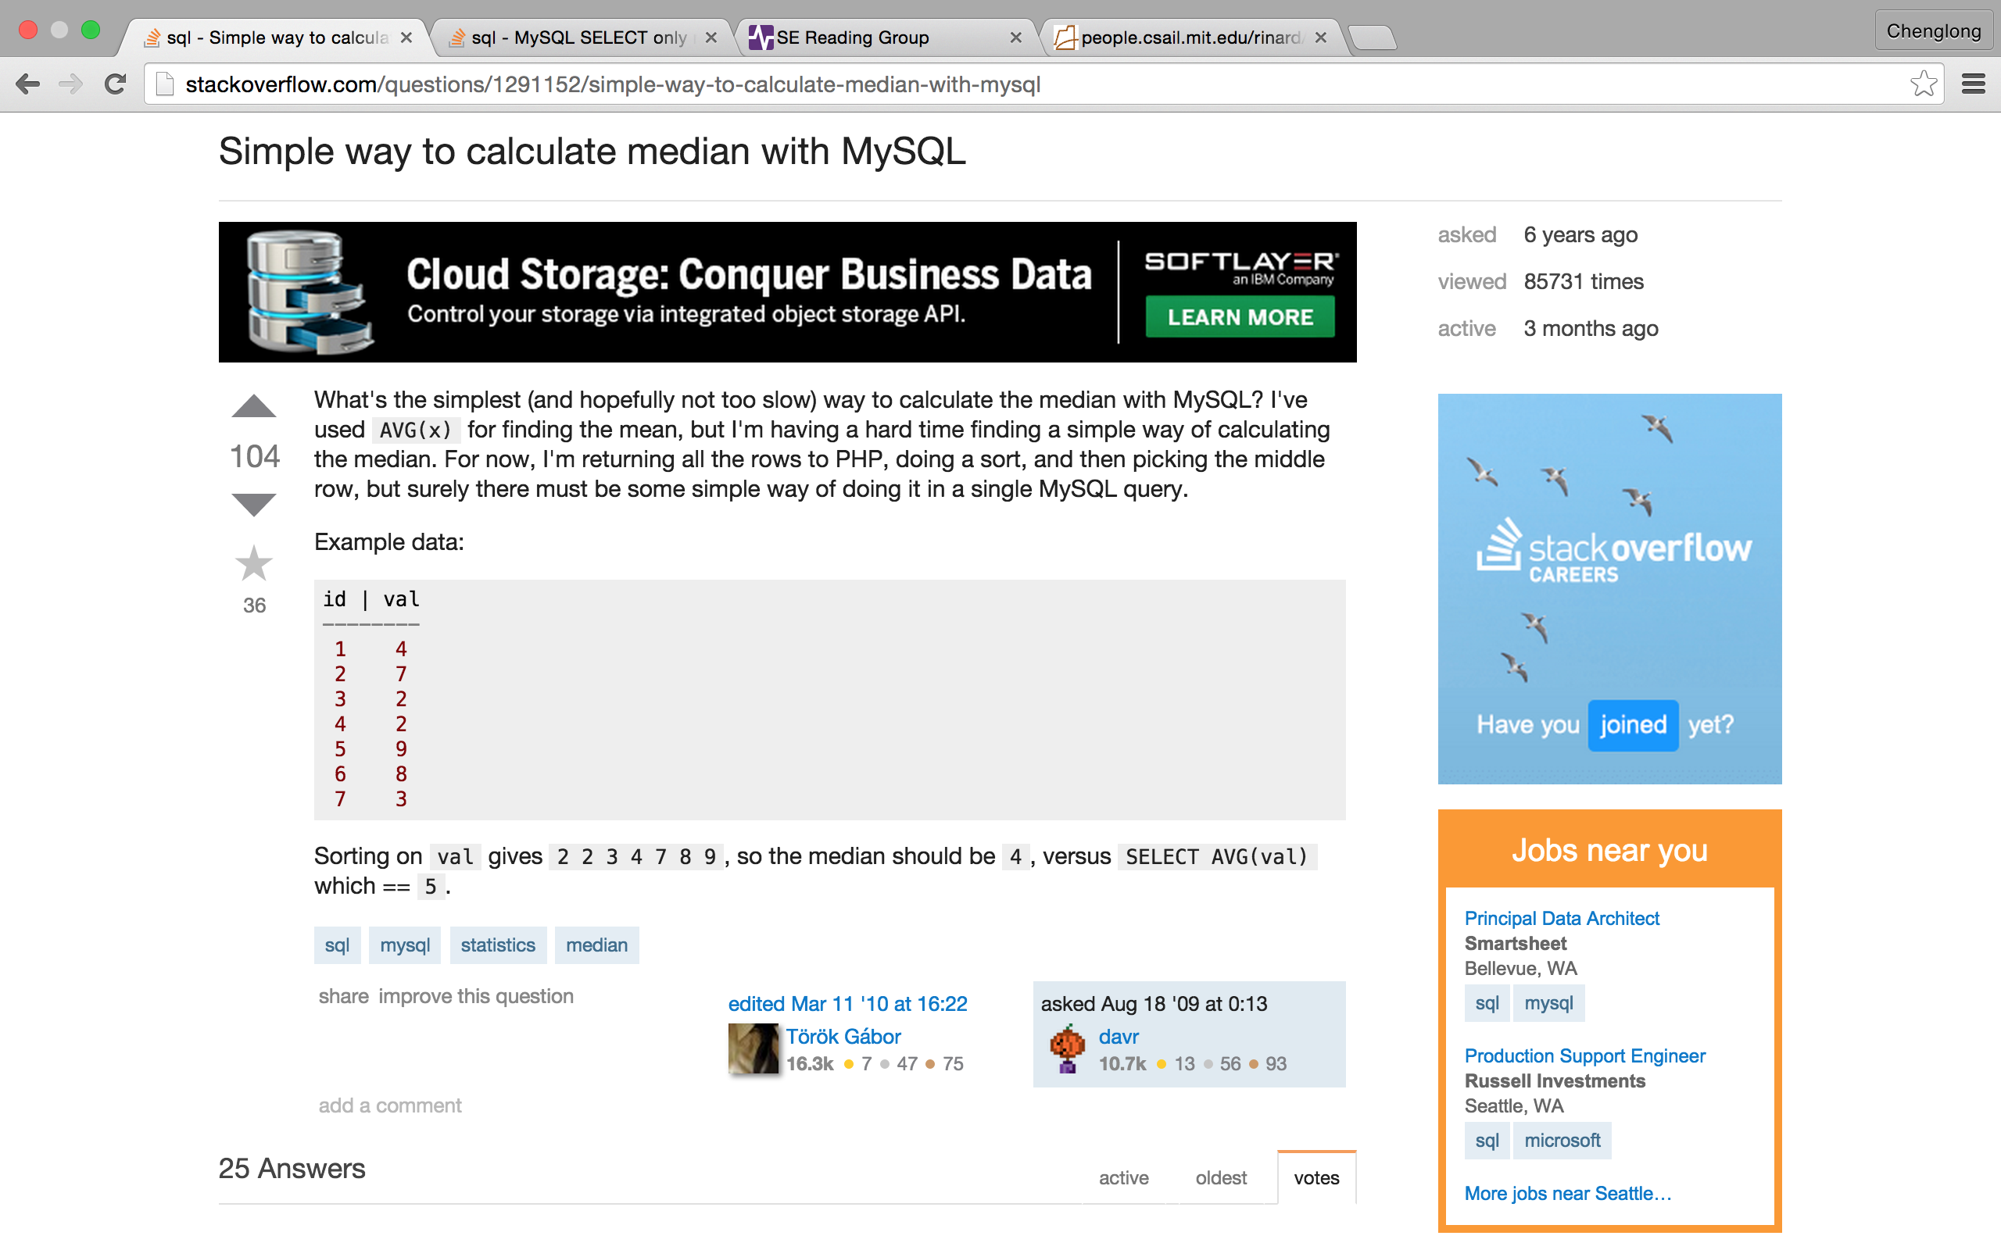
http://stackoverflow.com/questions/1291152/simple-way-to-calculate-median-with-mysql

Slide 57
Date-related

Slide 58
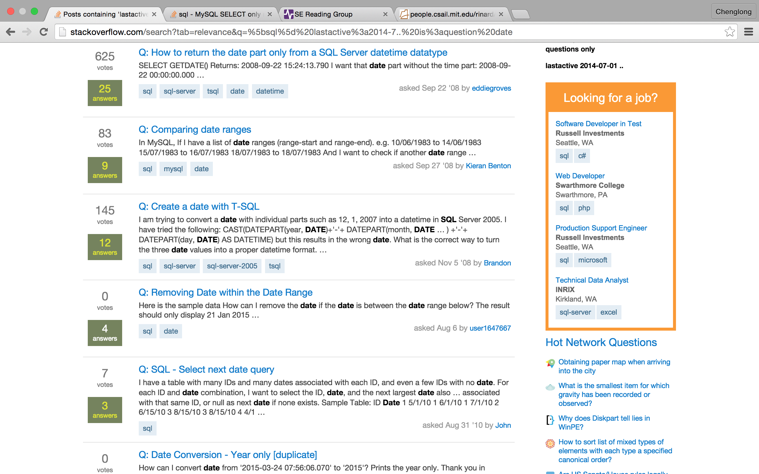

Slide 59
Part II: A demonstration of SQLShare log data
Incrementally build a complex query from simple small queries.
Modify some conditions in a query to achieve a slightly different goal.

Slide 60
Example 1-1

Slide 61
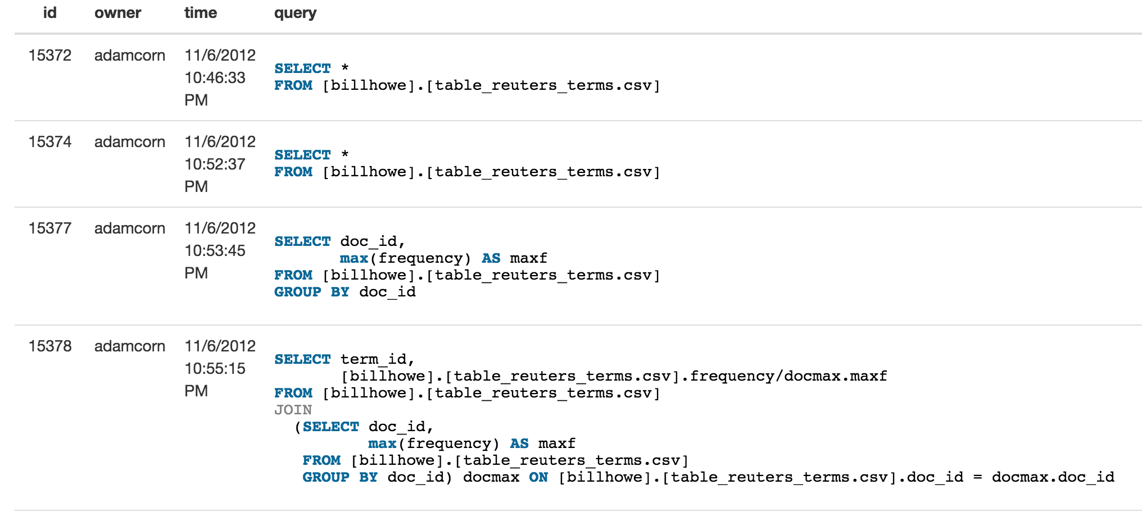

Slide 62
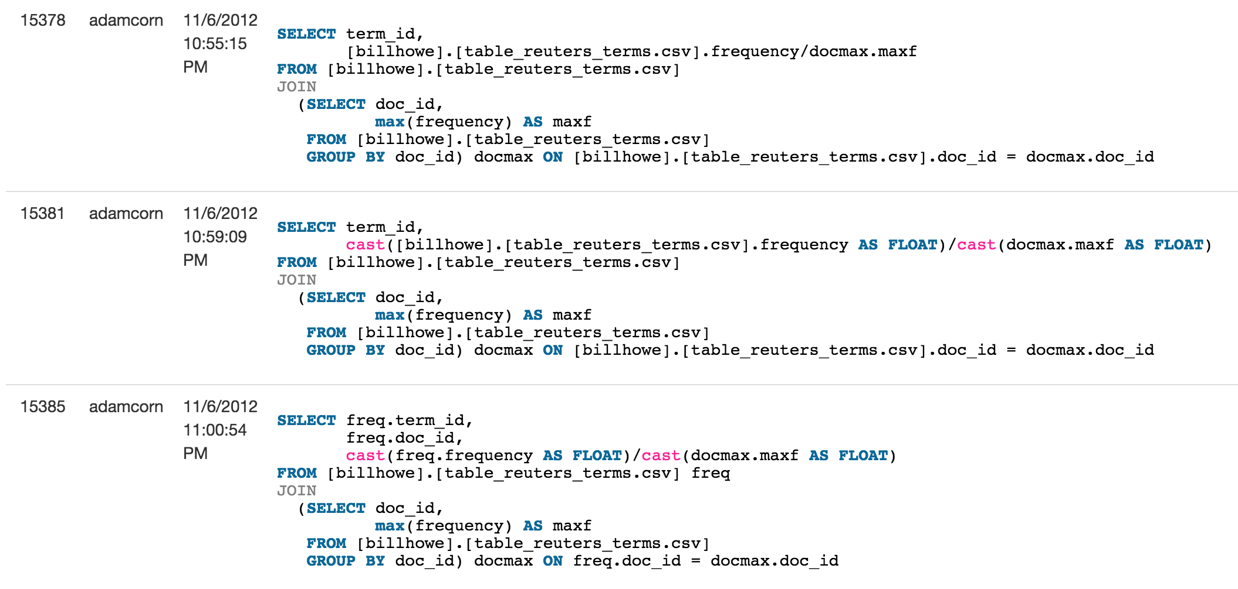

Slide 63
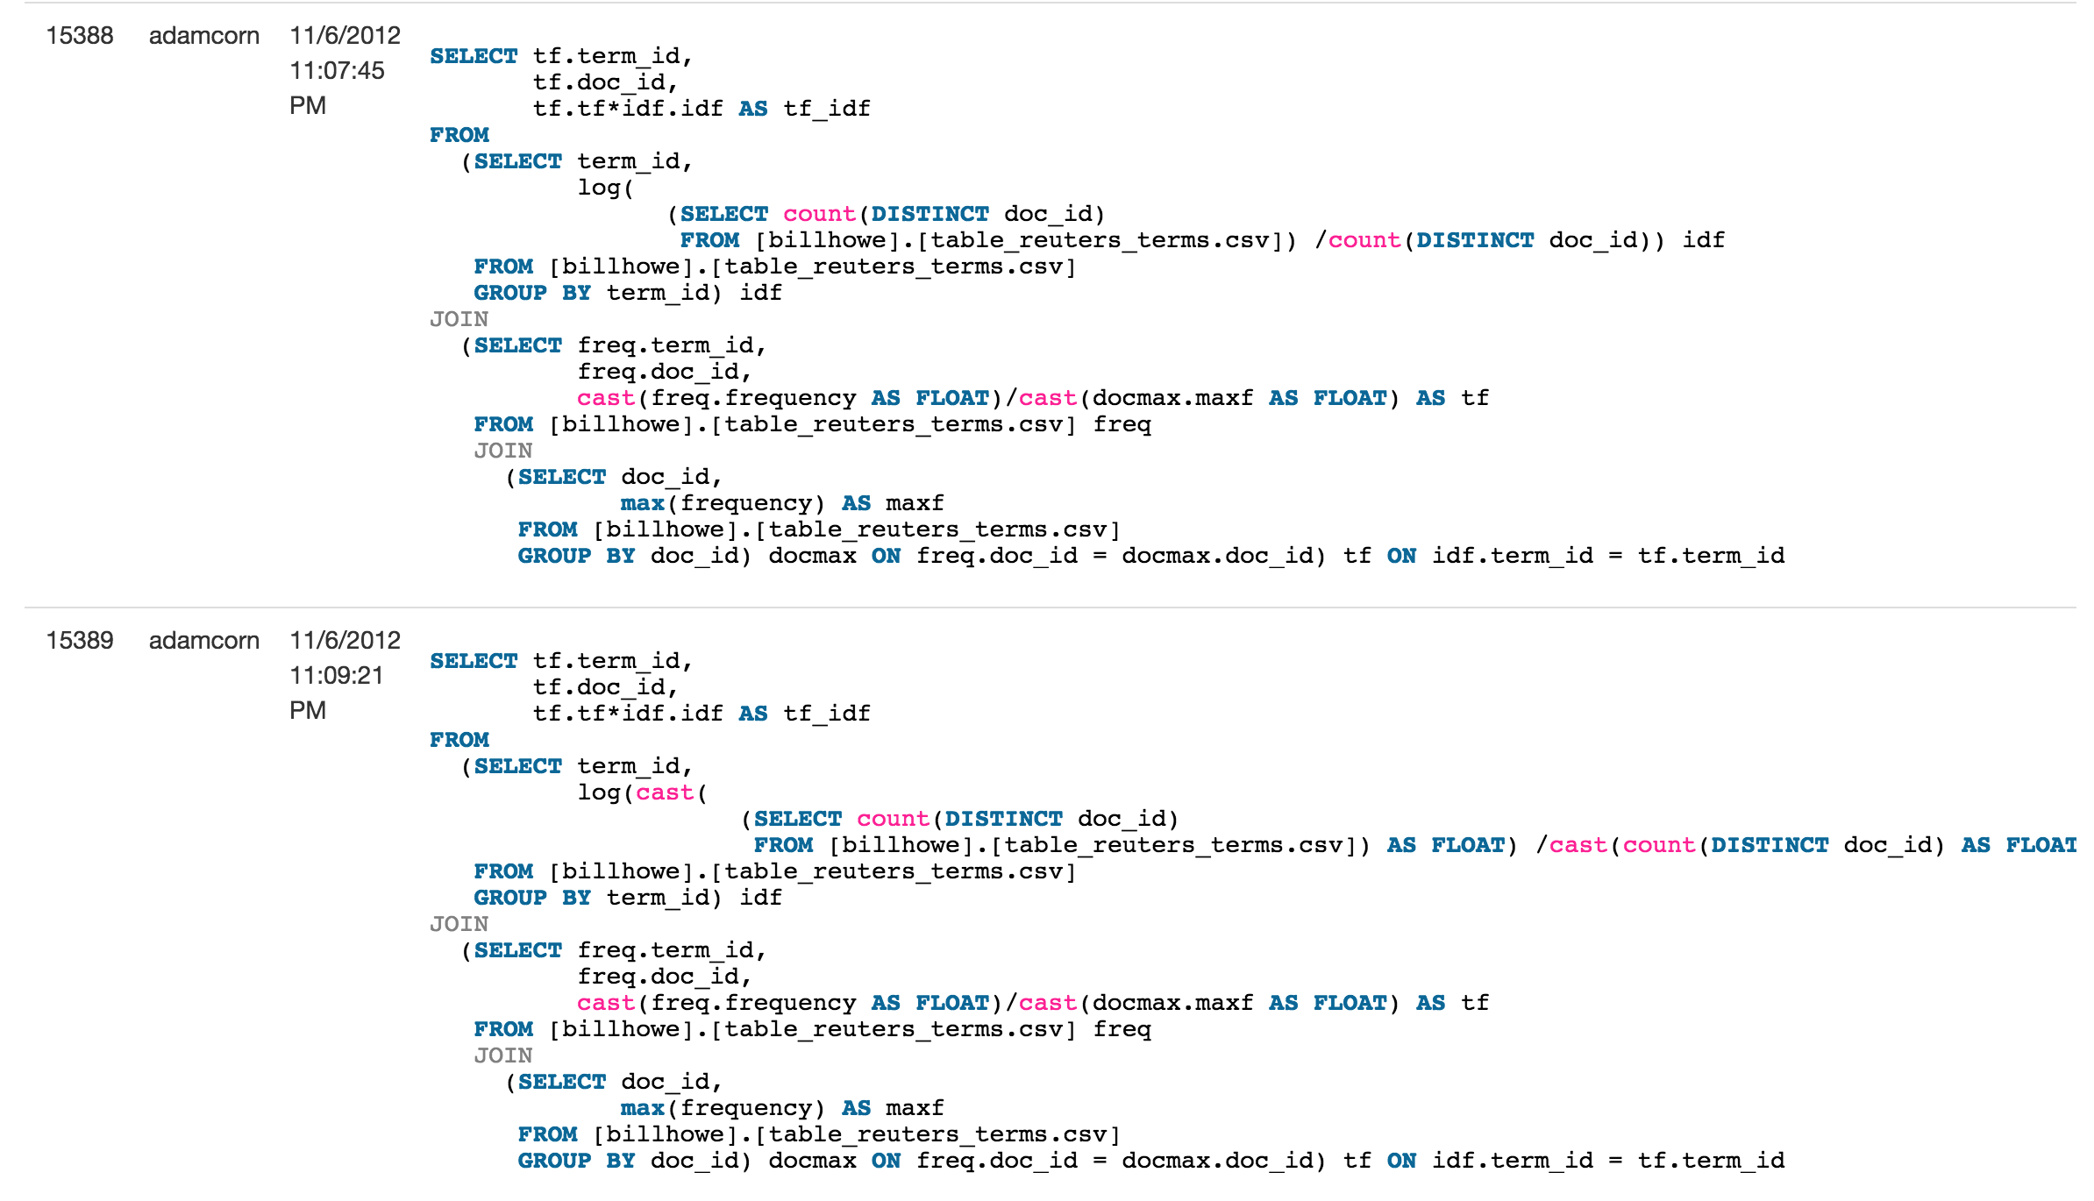

Slide 64
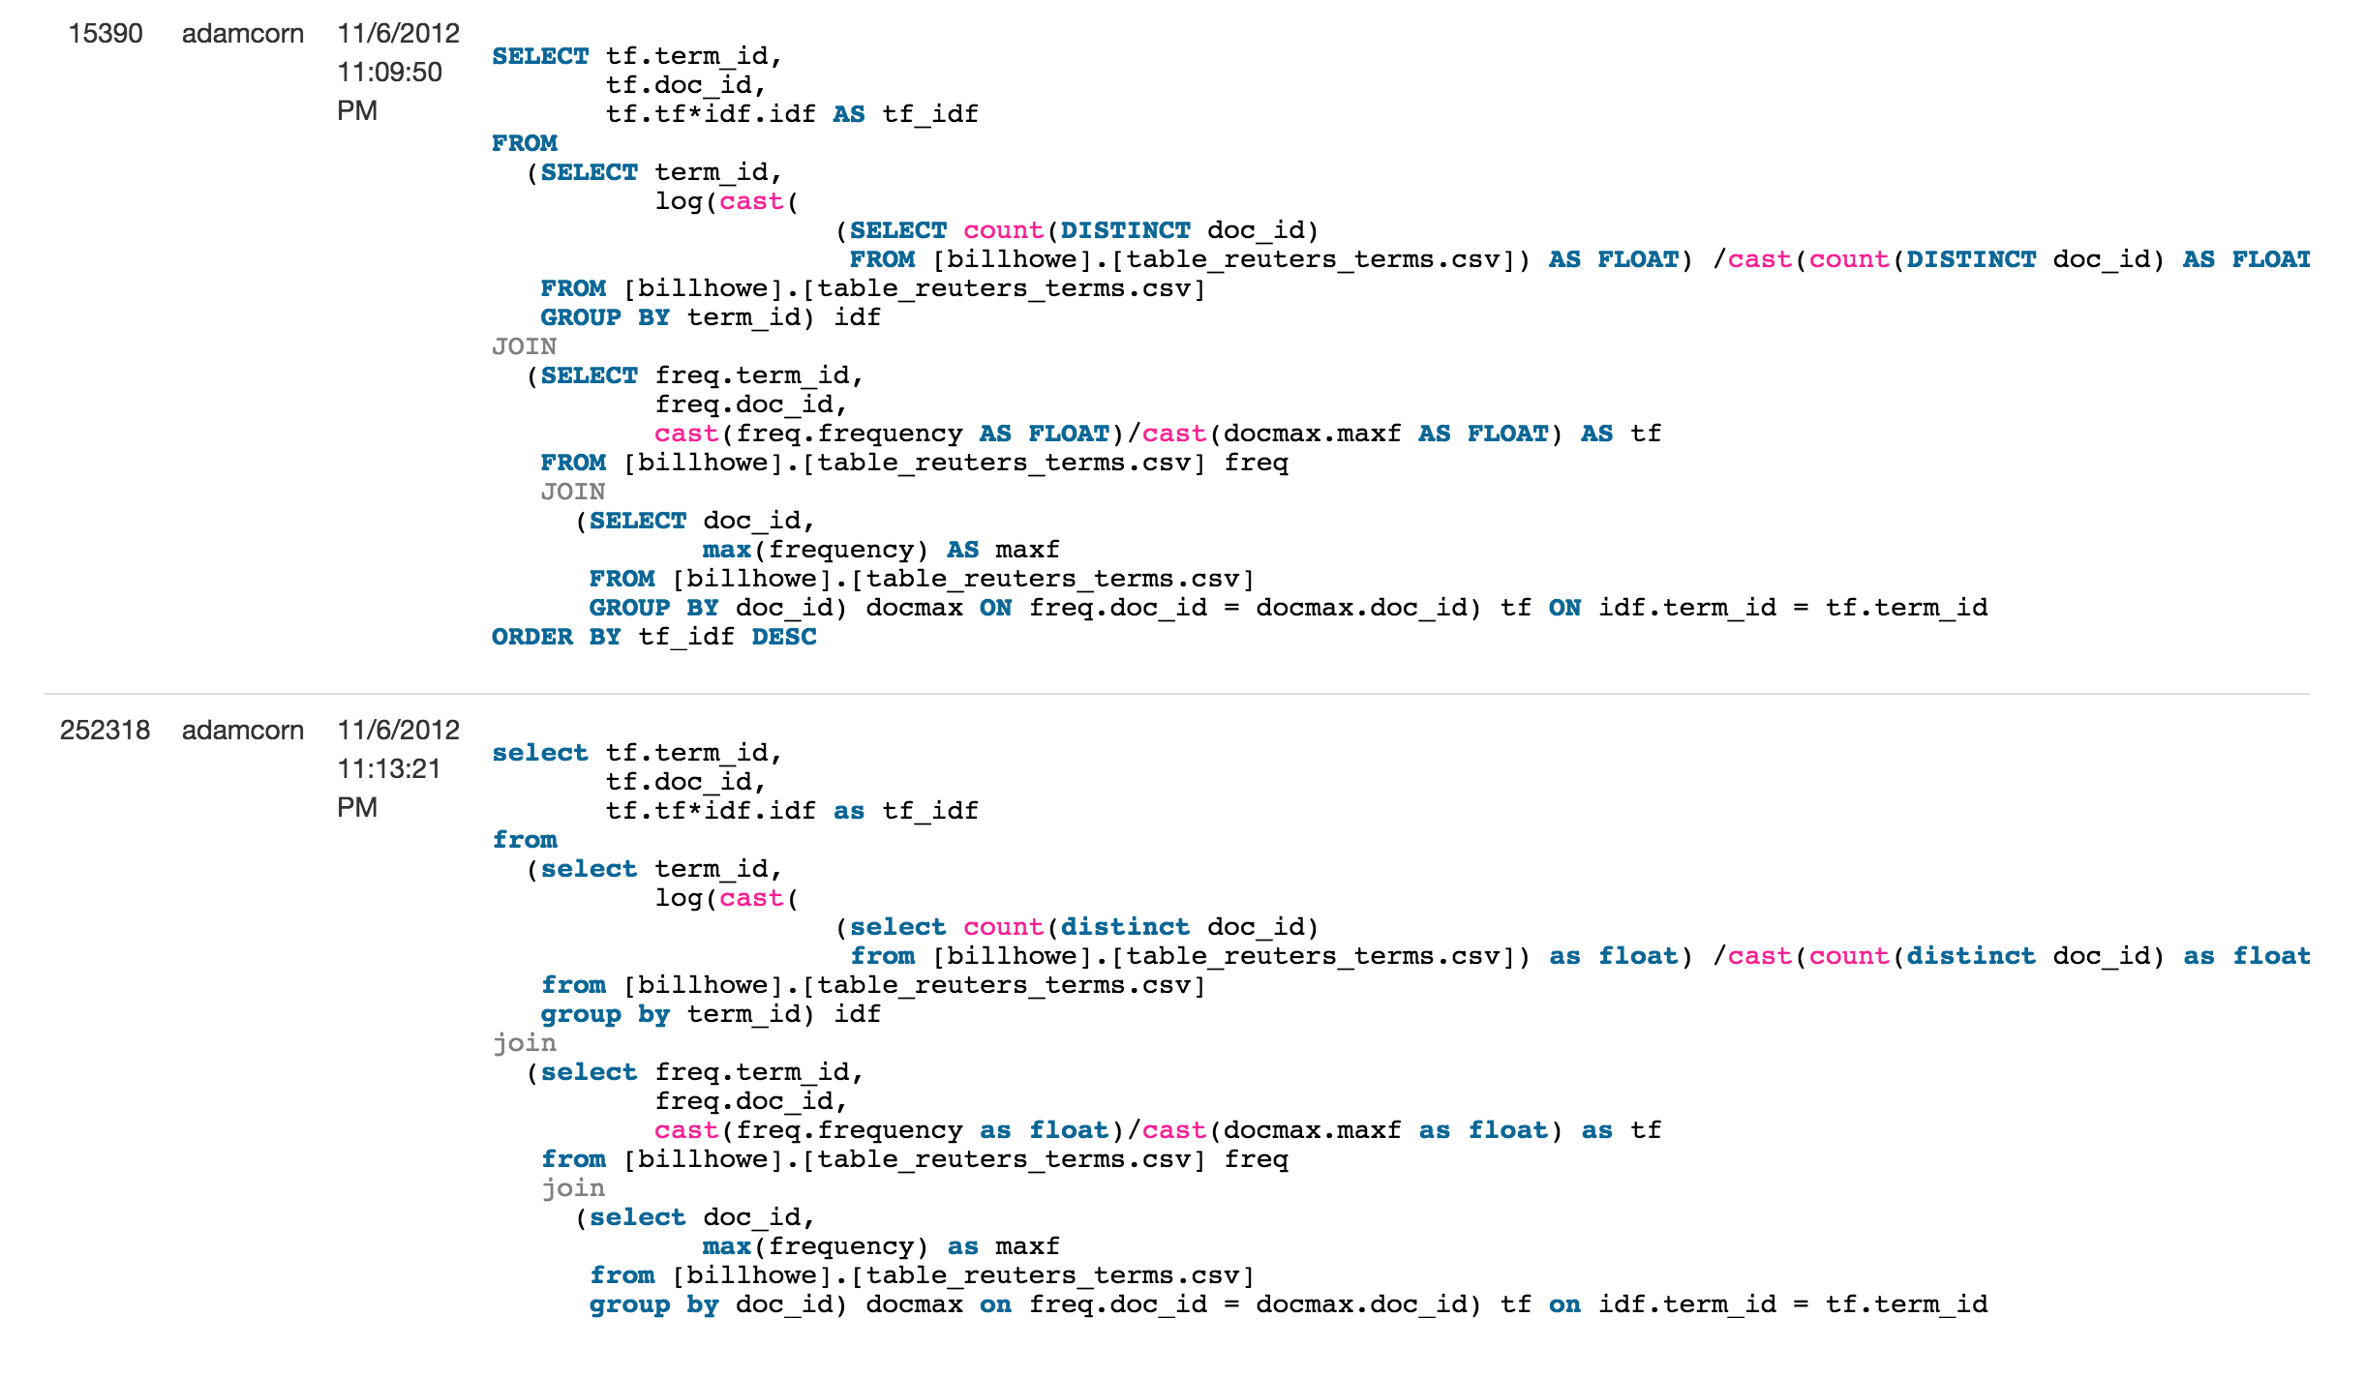

Slide 65
Example 1-2

Slide 66
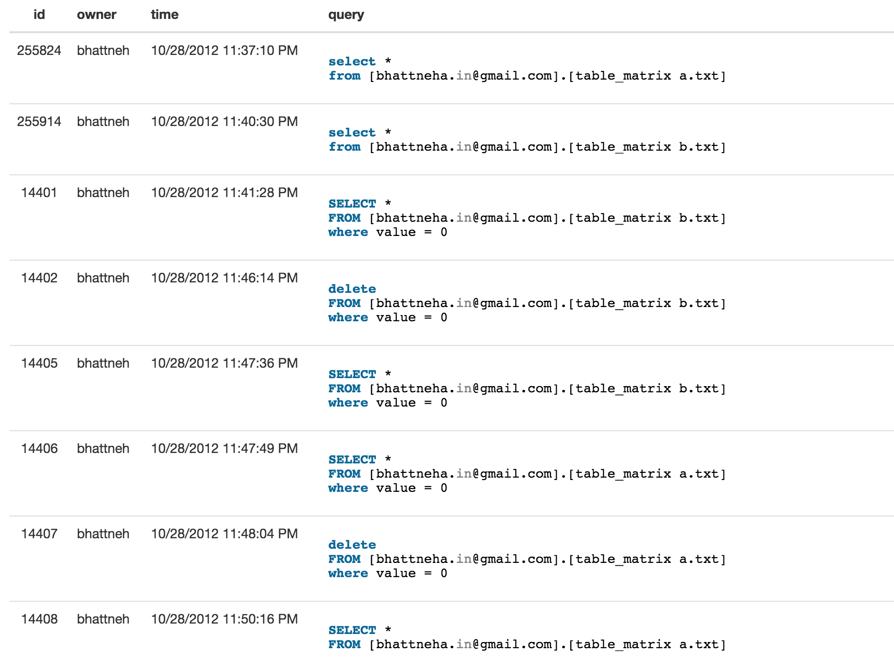

Slide 67
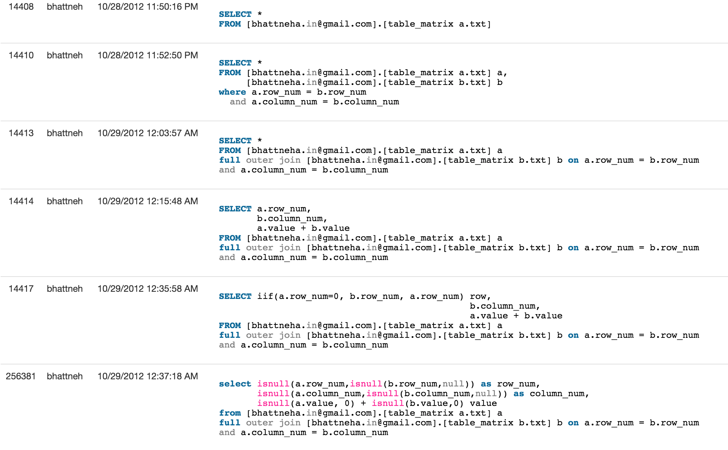

Slide 68
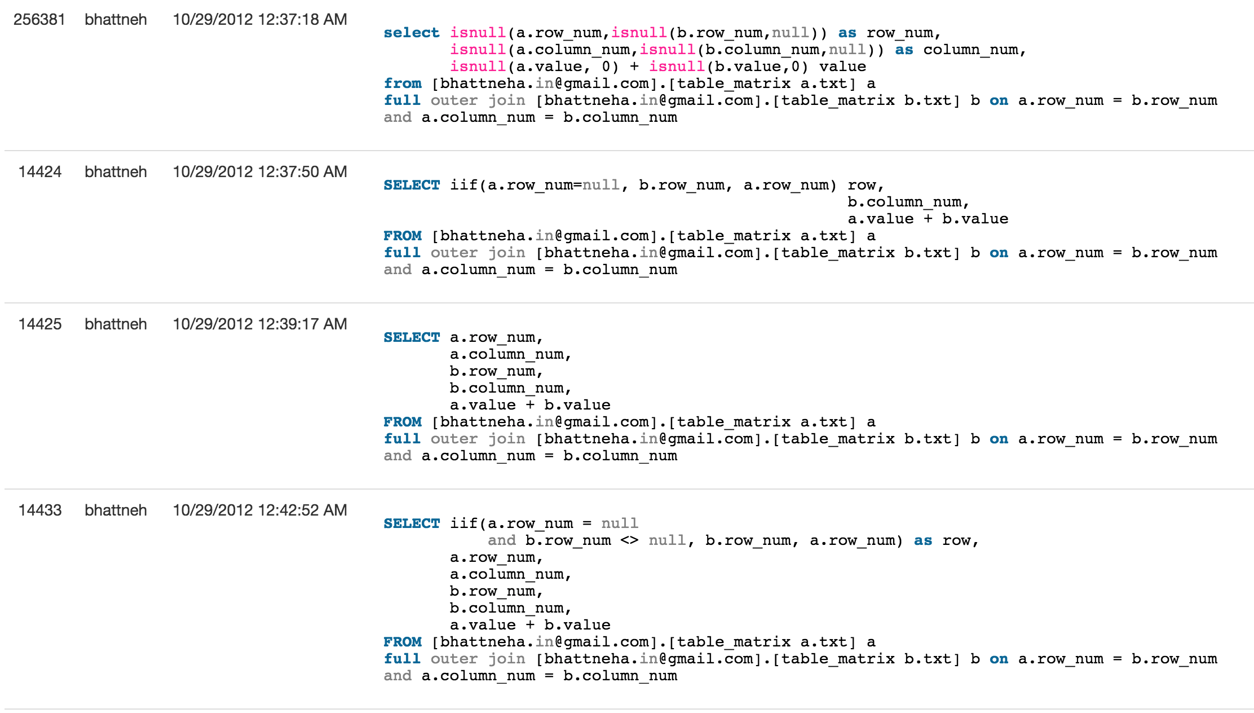

Slide 69


Slide 70
Example 1-3

Slide 71


Slide 72
Example 2-1

Slide 73


Slide 74
Example 2-2

Slide 75


